Slide 1
How to Buy a Business

Slide 2
Edward L. Perkins, BA, JD, LLM(Tax), CPA
Partner - Gibson & Perkins, PC
tedperkins@gibperk.com 610.565.1708 ext. 102
Adjunct Professor
Villanova University School of Law - Graduate Tax Program
Founder - YourOnlineProfessor.net

Slide 3
Martin J Pezzner, BS, JD, CPA
Gibson & Perkins, PC
Martin J Pezzner has a wealth of experience as a practicing attorney for over twenty-nine years. After graduating Wilkes College with a Bachelor of Science in accounting, he was employed by the Internal Revenue Service in Philadelphia, PA as a Tax Revenue Agent (Field Agent) for five years.
He also worked for one year in the Philadelphia IRS Appeals Office. While employed by the IRS, he became a CPA (1985) in the Commonwealth of Pennsylvania.
Mr. Pezzner received his Juris Doctorate Degree from the University of Dayton School of Law in 1989.

Slide 4
www.gibperk.com
www.perkinsequitygroup.com
GIBSON&PERKINS, PC is a multi-practice law firm with offices in Pennsylvania and Delaware. Our firm has expanded from its founding in 2001, into a vibrant and growing law firm dedicated to serving an ever expanding and sophisticated client base.
We represent clients in matters pertaining to:
Business Transactions
Real Estate
Estate Planning
Estate Administration
Tax Problem Resolution
Emerging Businesses
Commercial Litigation

Slide 5
CLE - Continuing Legal Education for
Attorneys: YourOnlineProfessor.net is an Accredited Provider for Pennsylvania Continuing Legal Education, through The Supreme Court of Pennsylvania's Continuing Legal Education Board, registered as sponsor #7003.
This program qualifies as 1 hour - ‘Live Webcast’ under PA CLE Board guidelines and in the states of Delaware, New Jersey, and California.
In most cases, credit is also available to New York attorneys through New York’s “approved jurisdiction policy.”

Slide 6
CPE - Continuing Professional Education for
CPAs:
YourOnlineProfessor.net is registered with the Pennsylvania Department of State's Bureau of Professional and Occupational Affairs as a Program Sponsor under the State Board of Accountancy. Our license number is PX177605.
This Course will count as 1.0 Hour of Group Internet Based or Interactive Self Study Credit depending on how you access the Course.
For CPAs taking an archived version of the Course for Interactive Self Study Credit successful completion of a Final Examination is required. The Final Slide will direct you as to how to access and complete the Final Examination.

Slide 7
NASBA Registry of CPE Sponsors
YourOnlineProfessor.net is registered with the National Association of State Boards of Accountancy (NASBA) as a sponsor of continuing professional education on the National Registry of CPE Sponsors. State boards of accountancy have final authority on the acceptance of individual courses for CPE credit. Complaints regarding registered sponsors may be submitted to the National Registry of CPE Sponsors through its website: www.learningmarket.org.
Our Sponsor No. Identification Number 137573

Slide 8
Where Applicable, this program is © YourOnlineProfessor.net - All Rights Reserved.
This material is designed for informational purposes. In providing this material, neither the author nor YourOnlineProfessor.net are engaged in rendering legal, accounting or professional service. If legal, accounting, or professional service is required, the service of a competent professional should be sought.
Inquiries regarding the use of the material contained I in this Course should be addressed to:
Ted Perkins
c/o YourOnlineProfessor.net Suite 204 100 W. Sixth Street Media, PA 19063

Slide 9
Verifying Your Attendance
Attendees will be asked to periodically verify their attendance in order to comply with CPE/CLE guidelines.
This involves typing “I’m still here!!! into the chatbox and pressing ‘Enter’ when prompted.
It is important that you follow all such prompts
in order to ensure that your CPE/CLE credits are received in full.

Slide 10
Technical Support
If you have issues during the presentation, please email
Sean Tait
stait@gibperk.com
or 610 565 1708 Ext 104
for real-time troubleshooting assistance.

Slide 11
Questions
If you have any questions during the program, please type them into the chat box and I will try to address them during the program.
If your question is not answered during the program you will receive an ‘ e-mail response after the program is concluded.
If you have questions after the program is concluded please e-mail your question to –
tperkins@gibperk.com
mpezzner@gibperk.com

Slide 12
How to Buy a Business

Slide 13
Overview

Slide 14
Time Line of the Transaction -
Initial Stage
Due Diligence Stage
Formal Agreement Stage
Closing
Post Closing

Slide 15
Buyer’s always want to…
Get what they paid for
At the best price
Without unanticipated post-closing cost or
Surprises

Slide 16
Representing the Buyer
To help a properly represent the Buyer you must first understand the Buyer’s wants in acquiring the target Business.

Slide 17
Please Verify your Attendance

Slide 18
Different Buyers - Different Wants

Slide 19
Financial Buyer or Strategic Buyer
Strategic Buyer
A strategic buyer is typically after horizontal or vertical expansions, looking for strategic synergies that will improve their operations.
Their primary objective is to identify a business whose products and/or services can be quickly absorbed into their own or existing operations.
Financial Buyer
A financial buyer, on the other hand, is interested in making an investment in a company and realizing considerable returns from it.
Typical financial buyers are Private Equity Firms that use leverage to try and realize large financial returns.
So the main task of a financial buyer is to identify companies with excellent growth potential and, thereby, make good their investment within a period of five to seven years.

Slide 20
Buyer of a Restaurant
Goodwill
Name
Location
Assets of the on-going business
Liquor License
Franchise

Slide 21
Buyer of a Service Business
Client List
Personal Goodwill
Purchase Price may be based on future income

Slide 22
Buyer of a Business Based on Product Resales and Service Contracts
Source of Products
Supplier Agreement
Client List
Transferability of Service Contracts
Equity Agreement
Key Employees

Slide 23
Product Manufacturer
Manufacturing facility or source
Product Protections (patents, trademarks, copyrights)
Warranty Agreements
“Product Line” liability
Key Employees
Union Agreements

Slide 24
Getting What You Paid For

Slide 25
Due Diligence
The first step in getting what you paid for is proper due diligence
Due diligence focused on the objectives of the Buyer

Slide 26
Due Diligence
> Financial Statements
>Tax Returns
> Good Standing Certificate
>Tax Clearance Certificate
> Lien Search
> Judgement Search > Litigation Search

Slide 27
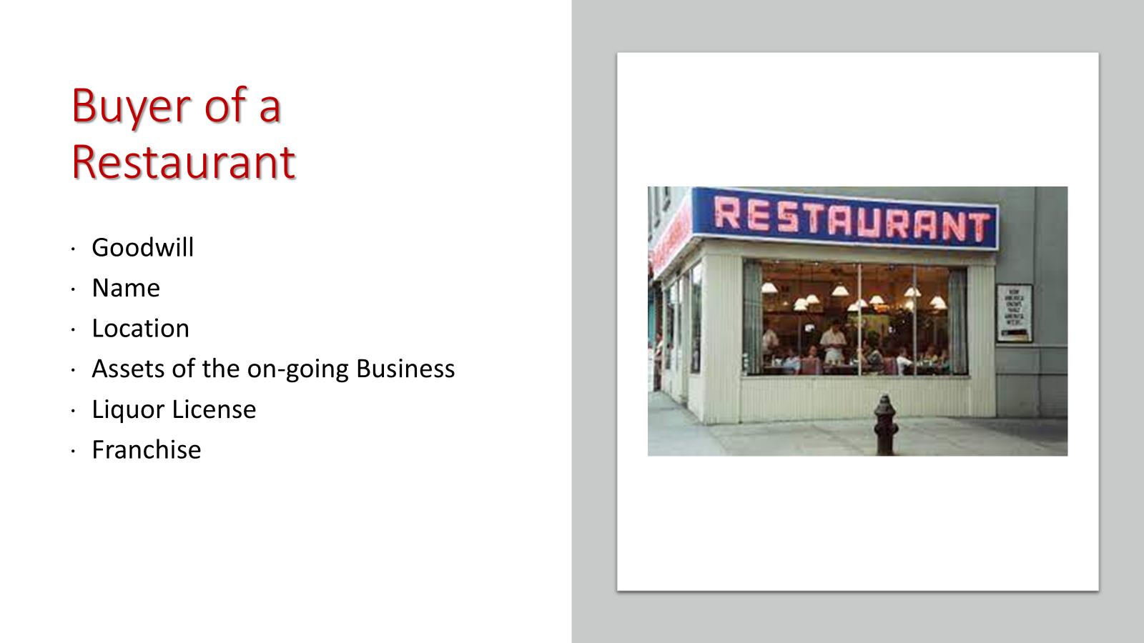
Due Diligence
>Organization and Good Standing
> Financial Statements
>Tax Returns
>Condition of Physical Assets
>Lien Search
>Liquor License Violations and Transferability
>Status of Franchise
>Lease for Location
>Employee Benefits

Slide 28
Due Diligence
>Organization and Good Standing
>Financial Statements
>Tax Returns
>Quality of Earnings
> Client List

Slide 29
A business’s customer base has a major impact on its value.
A diverse customer base means revenue comes from a number of clients or customers, not just two or three, and preferably comes from multiple sources.
The more customers contributing to a business’s sales revenue without a few dominating that figure, the more valuable the business will be.
This is because it reduces the risk of serious cash flow issues if one or more customers do not stay under new ownership.
A business serving a multiplicity of customer types, or customers in unrelated industries, that are not affected by the same economic conditions further mitigates risk.
Client Base

Slide 30
Due Diligence
> Supplier Agreements
>Quality of Earnings
>Client Base
>Employment Agreements
>Employee Benefits

Slide 31
Quality of Earnings Audit
In a quality of earnings audit the focus is on the economic earnings vs. the balance sheet serving as the focus in an audit
A quality of earnings audit is a consulting engagement, not an attest service, providing flexibility in the approach and scope; and the materiality is much lower in a quality of earnings study than an audit.

Slide 32
Quality of Earnings Audit
In order for an earnings measure to be considered of high quality, it must reflect free cash flow and it must be sustainable.
Earnings that are “tied up” in accounts receivable, for example, do not have much value because, despite being recognized, they have not yet been realized.
In the same vein, earnings that are not sustainable because of understated expenses due to an unfilled executive position, as an example, would overstate sustainable earnings.

Slide 33
Due Diligence
> Real Estate
>Product Protection
>Warranty Agreements
>Liability Insurance
>Employee Benefits
>Union Contracts
> Employment Agreements

Slide 34
The Right Price

Slide 35
The Purchase Price
The purchase price is more than number
It is also
How you pay
When you pay, and
What you pay for

Slide 36
Setting the Purchase Price
Both the Buyer and the Seller will want to set the Purchase Price early in the negotiation ......
..... they’re both wrong!!!

Slide 37
The Number

Slide 38
EBITDA as Adjusted to Determine Price.
The term “EBITDA” means “earnings before interest, taxes, depreciation, and amortization.”
EBITDA is one way to measure how much a company is earning,
Allows a buyer to estimate the return on investment the buyer will receive should it purchase a company.
In order to make the EBITDA of one company comparable that of another company, earnings are normally adjusted by excluding items that are variable or discretionary.

Slide 39
ADJUSTED EBITDA X MULTIPLER = VALUE OF THE BUSINESS
EBITDA as Adjusted to Determine Price.
The value of a business is almost always dependent on earnings.
Companies often are priced and sold to third parties based on a multiple of the company’s “EBITDA”, as adjusted.
For example, a company with an adjusted EBITDA of $1,000,000, could be sold for $5,000,000, i.e., five times EBITDA.
Therefore, it is important to have an understanding of how EBITDA is calculated and adjusted and also what the appropriate multiple might be applied in estimating a company’s value for a third-party buyer.

Slide 40
The Adjustments
For example, one company may have a heavy debt while another may have none. As a result, interest expense is excluded.
Since companies have different tax strategies taxes are also excluded.
In order to make EBITDA more reflective of actual cash flow, depreciation and amortization, which non-cash expenses, are also excluded.

Slide 41
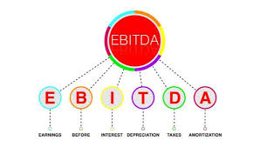
The Adjustments
To determine an EBITDA amount more reflective of the earnings of the business under the management of the buyer, EBITDA is generally adjusted by eliminating expenses that would not be incurred by the buyer.
One example of such an adjustment is for expenses which were for the sole benefit of the selling owner.
This may include excessive compensation and other owner perks, such as personal expenses written off as company expenses.

Slide 42
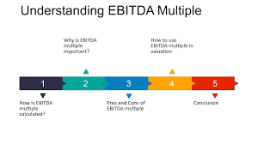
The Multiple
Various industries will have different EBITDA multiples because different industries have different growth prospects, financial performance, and financial metrics.
The most significant reasons for the difference in multiples between industries are the growth rate of the industry and the incremental cost of achieving incremental sales.
All else being equal, it makes sense that a company in a low-growth rate industry with high costs to achieve incremental sales will sell for a lower multiple than a company in an industry with a high growth rate and relatively lower costs to achieve incremental sales.

Slide 43
Future Earnings as a Factor
Valuation comes down to how much money the business will produce in the future and the risk factors associated with generating that money.
For larger companies, great effort is placed in modeling the future, then discounting that stream of cash to present-day dollars.
. An assessment of future earnings is also a factor in valuing small and mid-size companies.

Slide 44
Good Financial Records.
Good financial records that accurately reflect the condition of the business are essential to make a buyer comfortable in knowing they are getting what they are paying for.
Of course, a financial statement if audited by an independent accounting firm is considered the most accurate and relevant.
That being said even a compiled statement that has been prepared by an accountant but has not been audited or certified will have a higher level of creditability than self-prepared financials.
A schooled buyer will also request income tax returns to compare the information on the financial statements against the same information as reported on the tax returns.

Slide 45
Strong Management
Buyers focus on the continuity of the business, and strong management plays a key role.
Is the business dependent on the owner?
Is the owner staying?
Is there a management team in place if the owner is leaving?
Buyers will pay a premium for a business in which the owner has built a solid management team and the business is not heavily dependent upon the principal owner.

Slide 46
Please Verify your Attendance

Slide 47
How You Pay and When You Pay

Slide 48
Form of the Consideration.
All Cash
Promissory Note
Earn Outs
Assumption of Debt
Stock of the Purchaser

Slide 49
Buyer’s Promissory Notes
In many cases the Seller will be willing to or have to accept the Buyer’s promissory note as part of the purchase price
Payment in the form promissory note is good for the Buyer
.

Slide 50
Set-Off Rights
Buyer may also like the idea of using a promissory note for all or a portion of the purchase price in order to ensure that there are funds available against which it can offset any indemnification claims that it may have against seller.
In order to protect any set-off rights that it may have, the buyer will want to require that the promissory note be non-negotiable.

Slide 51
Earn Out Agreements
An earnout agreement, made between a business's buyer and seller, is paid by the buyer to the seller after meeting certain performance targets after the sale.
This type of agreement, serving as a contingency payment, may be paid in company stock or cash.
Common earnout candidates are companies with new, not-yet-proven products or high-growth businesses.
For service businesses, situations in which the owner's ongoing relationship with customers is important to success might also hold earnout potential.

Slide 52
Minimum Working Capital Requirement
“(iii) The “Working Capital Adjustment” shall mean the amount calculated on the Closing Date as follows:
(1) The “Target Working Capital” is One Hundred and Fifty Thousand ($150,000.00) Dollars.
(2) “Working Capital” is the difference between current assets and current liabilities determined according to Generally Accepted Accounting Principles (“GAAP”).
(3) In the event that the Working Capital of the Company exceeds the Target Working Capital, the Working Capital Adjustment shall be equal to such excess amount.
(4) In the event that Working Capital of the Company is less than the Target Working Capital the Working Capital Adjustment shall be equal to such negative amount.”

Slide 53
Please Verify your Attendance

Slide 54
What You Pay For

Slide 55
Form of the Deal - Stock Sale v. Asset Sale
Seller prefer a Stock sale
> Lower tax
> Liabilities are generally assumed
Buyer will prefer an Asset transaction
> Receives a step-up in basis
> Can pick and choose
> More insulated from the liabilities of the Seller.

Slide 56
Buyer’s Liability Exposure
Assets sale transactions are favored by Buyers because of the reduced exposure to the liabilities of the Seller
There are situations where the Buyer may have liability exposure
There are ways to reduce Buyer’s liability exposure even in an equity sale

Slide 57
Express or Implied Assumption
De Facto Merger
Mere Continuation
Fraud
Inadequate Consideration
The “Product Line” Exception
Duty to Warn
Environmental Torts
Labor Law Liability
Employee Benefits
Bulk Sales Compliance
FIRPTA

Slide 58
Please Verify your Attendance

Slide 59
Letter of Intent

Slide 60
The Letter of Intent
> Serves to narrow the issues
> Should be non-binding
> Include confidentiality provision
> Should set a timeline

Slide 61
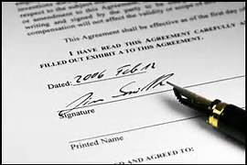
The Letter of Intent
The LOI generally states the basic terms of the deal:
What is the price?
What are the payment terms?
What is the form of the consideration?
What contingencies?

Slide 62
What does the Buyer need to happen…
Financing
Due Diligence/Inspection
Contracts transferred
Secure the location
Transfer of specific strategic asset (e.g., liquor license )
Retention of a Key Employee
Condition and suitability of the assets acquired
Third Party consent (e.g., franchise transfer)

Slide 64
Questions
If you have any questions during the program, please type them into the chat box and I will try to address them during the program.
If your question is not answered during the program you will receive an ‘ e-mail response after the program is concluded.
If you have questions after the program is concluded please e-mail your question to –
mpezzner@gibperk.com
tedperkins@gibperk.com 610 565 1708 Ext 104

Slide 65
TedPerkinsTax News
COURSE EVALUATION
Thank you for attending our program.
You will shortly receive an email with a link to the replay of today’s Course and a link to the Course Evaluation form.
Please complete this form, which helps us comply with the requirements of issuing CPE and CLE in various jurisdictions.

Slide 66
Express or Implied Assumption
> An agreement that provides that the buyer assumes and agrees:
“to pay, perform and discharge all debts, obligations, contracts and liabilities”, …
….could be interpreted broadly

Slide 67
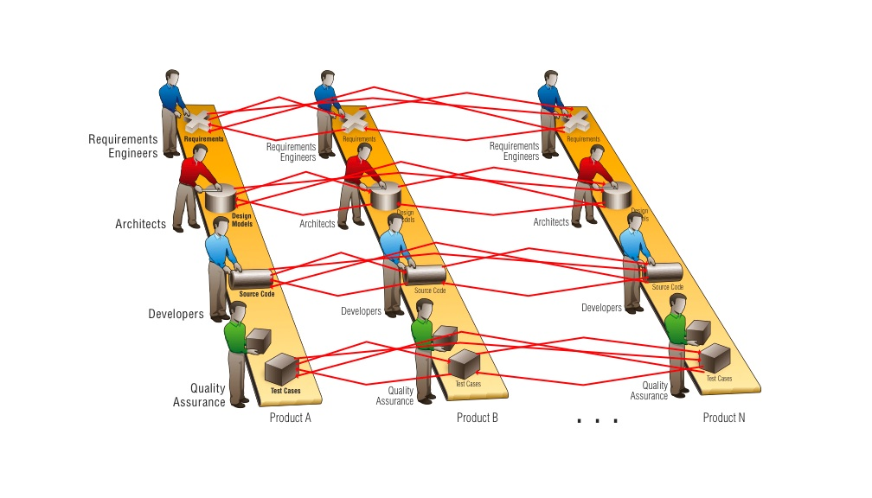
The Product Line Exception
Under the “product line” exception, a buyer may be held strictly liable for defective products manufactured by its predecessor.

Slide 68
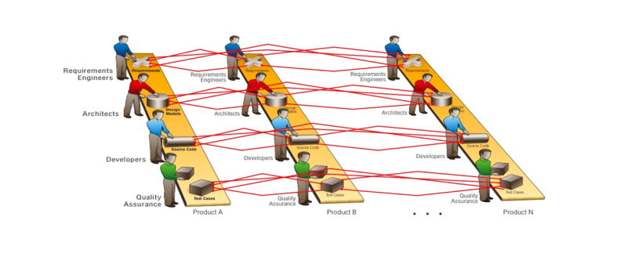
The Product Line Exception
This exception has been applied, in cases, where the buyer:
Acquires substantially all of the manufacturing assets of another corporation
Employs its factory personnel,
Continued to manufacture the same line of products under the seller’s name, and
Generally continued the seller’s business as before.

Slide 69
Successor Liability for the Seller’s Environmental Torts in Asset Acquisitions
Section 107(a)(2) of CERCLA extends liability for response costs to “any person who at the time of disposal of any hazardous substance owned or operated any facility at which such hazardous substances were disposed of.”

Slide 70
In Pennsylvania
Failure to obtain a Tax Clearance Certificate in a Bulk Sales transaction makes the Buyer liable for the unpaid taxes of the Seller.

Slide 71
Union Pension Plan Liability
In essence, a buyer of a business can be liable for the seller's unfunded pension liabilities under a union plan if they have notice of the obligation and there's a substantial continuity in the business operation after the sale, especially if the seller's actions or the buyer's subsequent actions trigger withdrawal liability events

Slide 72
Buyer Focus – Equity Purchase
Acquire good title to the Stock/Equity
Also acquire fair and marketable title to Assets free and clear of liens and liabilities
Liability exposure is greater
Due Diligence should be more comprehensive
Reps and Warranties provisions more expansive

Slide 73
Buyer Focus – Assets Purchase
Assets to be acquired
Acquire fair and marketable title to Assets free and clear of liens and liabilities
Liability exposure still exists but is less than in a Stock Purchase
Due Diligence should be focused on title and suitability of purchase
Reps and Warranties provisions can be more streamlined

