Slide 1

How to Buy a Business – Part Two
Drafting the Sales Agreement

Slide 2

Edward L. Perkins, BA, JD, LLM(Tax), CPA
Partner - Gibson & Perkins, PC
tedperkins@gibperk.com
610.565.1708 ext. 102
Adjunct Professor
Villanova University School of Law - Graduate Tax Program
Founder - YourOnlineProfessor.net

Slide 3

Martin J Pezzner, BS, JD, CPA
Gibson & Perkins, PC
Martin J Pezzner has a wealth of experience as a practicing attorney for over twenty-nine years. After graduating Wilkes College with a Bachelor of Science in accounting, he was employed by the Internal Revenue Service in Philadelphia, PA as a Tax Revenue Agent (Field Agent) for five years.
He also worked for one year in the Philadelphia IRS Appeals Office. While employed by the IRS, he became a CPA (1985) in the Commonwealth of Pennsylvania.
Mr. Pezzner received his Juris Doctorate Degree from the University of Dayton School of Law in 1989.

Slide 4


www.gibperk.com
www.perkinsequitygroup.com
GIBSON&PERKINS, PC is a multi-practice law firm with offices in Pennsylvania and Delaware. Our firm has expanded from its founding in 2001, into a vibrant and growing law firm dedicated to serving an ever expanding and sophisticated client base.
We represent clients in matters pertaining to:
Business Transactions
Real Estate
Estate Planning
Estate Administration
Tax Problem Resolution
Emerging Businesses
Commercial Litigation

Slide 5
CLE - Continuing Legal Education for
Attorneys:
YourOnlineProfessor.net is an Accredited Provider for Pennsylvania Continuing Legal Education, through The Supreme Court of Pennsylvania's Continuing Legal Education Board, registered as sponsor #7003.
This program qualifies as 1 hour - ‘Live Webcast’ under PA CLE Board guidelines and in the states of Delaware, New Jersey, and California.
In most cases, credit is also available to New York attorneys through New York’s “approved jurisdiction policy.”

Slide 6
CPE - Continuing Professional Education for
CPAs:
YourOnlineProfessor.net is registered with the Pennsylvania Department of State's Bureau of Professional and Occupational Affairs as a Program Sponsor under the State Board of Accountancy. Our license number is PX177605.
This Course will count as 1.0 Hour of Group Internet Based or
Interactive Self Study Credit depending on how you access the Course.
For CPAs taking an archived version of the Course for Interactive Self Study Credit successful completion of a Final Examination is required. The Final Slide will direct you as to how to access and complete the Final Examination.

Slide 7

NASBA Registry of CPE Sponsors
YourOnlineProfessor.net is registered with the National Association of State Boards of Accountancy (NASBA) as a sponsor of continuing professional education on the National Registry of CPE Sponsors. State boards of accountancy have final authority on the acceptance of individual courses for CPE credit. Complaints regarding registered sponsors may be submitted to the National Registry of CPE Sponsors through its website: www.learningmarket.org.
Our Sponsor No. Identification Number 137573

Slide 8
Where Applicable, this program is
© YourOnlineProfessor.net - All Rights Reserved.
This material is designed for informational purposes. In providing this material, neither the author nor YourOnlineProfessor.net are engaged in rendering legal, accounting or professional service. If legal, accounting, or professional service is required, the service of a competent professional
should be sought.
Inquiries regarding the use of the material contained I in this Course should be addressed to:
Ted Perkins
c/o YourOnlineProfessor.net
Suite 204
100 W. Sixth Street
Media, PA 19063

Slide 9
Verifying Your Attendance
Attendees will be asked to periodically verify their attendance in order to comply with CPE/CLE guidelines.
This involves typing “I’m still here!!! into
the chatbox and pressing ‘Enter’ when prompted.
It is important that you follow all such prompts
in order to ensure that your CPE/CLE credits
are received in full.

Slide 10
Technical Support
If you have issues during the presentation, please email
Sean Tait
stait@gibperk.com
or
610 565 1708 Ext 109
for real-time troubleshooting assistance.

Slide 11
Questions
If you have any questions during the program, please type them into the chat box and I will try to address them during the program.
If your question is not answered during the program you will receive an ‘
e-mail response after the program is concluded.
If you have questions after the program is concluded please
e-mail your question to –
tperkins@gibperk.com
mpezzner@gibperk.com

Slide 12
How to Buy a Business – Part Two
Drafting the Sales Agreement

Slide 13
Documenting the Deal

Slide 14

Agreement Provisions
Introductory Provision
Recitals
Purchase and Sale of Assets
Consideration/Purchase Price
Adjustments to the Purchase Price
Reps and Warranties
The Closing
Indemnity Provisions
Miscellaneous

Slide 15
Introductory Provisions

Slide 16

Introductory Paragraphs
The Agreement should -
> Set the date of the Agreement
> Properly identify the parties

Slide 17

Recitals
The “Whereas” clauses will set the factual background of the transaction,
In some jurisdictions, it may be considered to be conclusively true as between the parties.
WHEREAS, Seller is engaged in retail sales business in the Commonwealth of Pennsylvania (the “Business”);
WHEREAS, Shareholders own all of the issued and outstanding capital stock of Seller;
WHEREAS, Purchaser desires to purchase from Seller, and Seller desires to sell to Purchaser, certain specified assets of Seller used in the conduct of the Business, subject to the terms and conditions set forth in this Agreement; and
WHEREAS, an index of the location of the definition of defined terms used in this Agreement is set forth in Annex 1 attached hereto.
NOW, THEREFORE, in consideration of the foregoing premises and the mutual representations, warranties and covenants herein contained, and other good and valuable consideration, the receipt and sufficiency of which are hereby acknowledged, the parties hereto hereby agree as follows:

Slide 18

TedPerkinsTax News
Verify Your Attendance
Please type “present” into the chatbox on your screen and hit ENTER.
This is an important step which verifies your attendance and assures that your credit is received.
Thank you.

Slide 19
Purchase and Sale of Assets to be Purchased

Slide 20

The Property to be Sold and Purchased
Of course, one of the essential elements of any asset sale is the identification of the assets to be sold.

Slide 21

The Buyer may wish to include a clause like this:
“All assets used or held for use primarily in, or arise primarily out of or relate primarily to, the Business or the operation or conduct of the Business.”

Slide 22


List of Assets
4. Assets to be Owed by the Company at the Closing
(a) The Company owns on the Execution Date and will own at the Closing Date good and marketable title free and clear of any liens and liabilities to the following property interests except for properties and assets sold or otherwise disposed of in the ordinary course of business since the date of the Execution Date and subject only to liens set forth in Exhibit 4(a), hereto (the “Assets”):
(i) All usable and saleable inventory owned by the Company on the Closing Date) as set forth on Exhibit 4(a)(i);
(ii) All furniture, fixtures, machinery and equipment owned by the Company on the Closing Date, including without limitation those items specifically as set forth on Exhibit 4(a)(ii) (the “Fixed Assets”);
(iii) The legal right to use the trade name “Long Business Systems;”
(iv) The credits due to the Company from suppliers, as set forth on Exhibit 4(b)(iv);
(v) A list of the customers of the Company (the “Customer List”) as set forth on Exhibit 4(a)(v);

Slide 23
The Property to be Sold and Purchased
> Just as important is identification of the assets to be excluded from the sale.

Slide 24

Condition of the Property
Also to be considered is a reference as to the condition of the property purchased and sold.
“4.9 Equipment. All equipment included among the Assets is in good operating condition and repair, subject only to ordinary wear and tear and is adequate for its intended use.”

Slide 25
Purchase Price

Slide 26

The Purchase Price
The Purchase Price may be
> A fixed amount or
> Subject to adjustment either at or post-closing,
> Also include consideration outside the Sale of Assets transaction

Slide 27

Form of the Purchase Price
> All Cash
> Buyer’s Promissory Notes
> Assumption of Debt
> Stock of the Buyer
> Earn-Out

Slide 28
Adjustments to the Purchase Price

Slide 29

Adjustments to the Price
> Inventory Value
> Working Capital/Net Worth
> Earn Outs
> Contingent Price/ True Ups
> Hold Backs

Slide 30
Minimum Working Capital Requirement
(iii) The “Working Capital Adjustment” shall mean the amount calculated on the Closing Date as follows:
(1) The “Target Working Capital” is One Hundred and Fifty Thousand ($150,000.00) Dollars.
(2) “Working Capital” is the difference between current assets and current liabilities determined according to Generally Accepted Accounting Principles (“GAAP”).
(3) In the event that the Working Capital of the Company exceeds the Target Working Capital, the Working Capital Adjustment shall be equal to such excess amount.
(4) In the event that Working Capital of the Company is less than the Target Working Capital the Working Capital Adjustment shall be equal to such negative amount.

Slide 31

Earn Out Agreements
An earnout agreement, made between a business's buyer and seller, is paid by the buyer to the seller after meeting certain performance targets after the sale.
This type of agreement, serving as a contingency payment, may be paid in company stock or cash.
Common earnout candidates are companies with new, not-yet-proven products or high-growth businesses.
For service businesses, situations in which the owner's ongoing relationship with customers is important to success might also hold earnout potential.

Slide 32
Stock Roll Overs
A stock roll-over is where the buyer requires the seller to invest either by investing a portion of the purchase price in the acquiring entity or by accepting a portion in the form of an equity position in the acquiring entity.

Slide 33

Set-Off Rights
> Buyer may also like the idea of using a promissory note for all or a portion of the purchase price in order to ensure that there are funds available against which it can offset any indemnification claims that it may have against seller.
> In order to protect any set-off rights that it may have, the buyer will want to require that the promissory note be non-negotiable.

Slide 34

(b) Prepayments. Prepayments (which may be reflected as credits in accounts receivable) received by Seller prior to Closing for which Purchaser will be obligated to render future service, whether or not these payments have been recorded on Seller’s books, will be deducted from the Purchase Price, or if not identified until after the Closing, deducted from the Holdback.

Slide 35
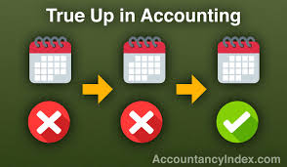
True Ups
    Delivery of the True Up Worksheet. Within one hundred twenty (120) days after the Closing Date, Purchaser shall cause to be prepared and delivered to Seller a “True Up Worksheet.” The True Up Worksheet shall be prepared from the books and records of Seller and the Business in accordance with generally accepted accounting principles in the United States (“GAAP”). If there is a Specified Asset Value Difference, the True Up Worksheet shall reflect Purchaser’s calculation of the final Specified Asset Value of Seller as of the Closing Date and the Specified Asset Value Difference. Within thirty (30) days following the one (1) year anniversary of the Closing Date, Purchaser shall cause to be prepared and delivered to Seller a supplement to the True Up Worksheet, which supplement shall reflect Purchaser’s calculation of the Net Annual Revenue of the Business for the twelve (12) month period ending on the one (1) year anniversary of the Closing Date (prepared in accordance with the definition thereof) and the amount of the Net Revenue Reduction, if any.

Slide 36
Liabilities Assumed

Slide 37

2.2 Liabilities.
(a) Assumption of Certain Liabilities. At the Closing, Purchaser shall assume only the executory duties and obligations of Seller as a party under the Assigned Contracts, to the extent arising from and after the Closing Date (excluding (i) any executory duties or obligations of Seller that relate to or arise from (in whole or in part) any breach, violation or default that occurred (or, upon the giving of notice or lapse of time or both, would have occurred) and (ii) those liabilities of Seller related to termite and/or moisture guarantees described in Section 3.5 (the “Excluded Executory Obligations”) at or prior to the Closing) (collectively, the “Assumed Liabilities”).
(b) Excluded Liabilities. Except for the Assumed Liabilities, it is expressly understood and agreed that notwithstanding anything to the contrary contained herein, neither Purchaser nor any of its Affiliates will assume or have any liability or obligation whatsoever with respect to any of Seller’s or any Shareholder’s obligations, liabilities, contracts, debts, claims, costs, expenses, agreements or understandings, of any kind or nature whatsoever at any time existing or asserted, whether or not accrued on Seller’s financial statements or recorded in their respective books and records, whether fixed, contingent or otherwise, whether known or unknown, whether arising prior to, on or after the Closing Date and whether or not relating to the operation of the Business or Seller’s ownership or use of the Purchased Assets (collectively, the “Excluded Liabilities”).

Slide 38
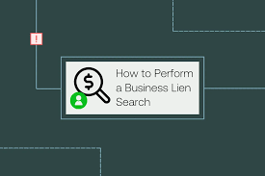
Basic Steps to Avoid Liabilities
Perform a Lien Search
Perform a Judgment Search
Obtain and Review Financial Statement
Obtain and Review Tax Returns
Have Seller provide a list of all outstanding debts and liabilities updated to the Closing Date
Bulk Sale Compliance – Obtain a Tax Clearance Certificate
Include “No debts” provision in the Reps and Warranties
Obtain payoff statements from each debtor
Provide for a structured payment at the Closing

Slide 39

Structured Payment
(e) At the Closing the Purchaser shall pay the Estimated Purchase Price, by wire transfer of immediately available funds into the account or accounts designated by each of the following, as follows:
(i) To the Persons entitled thereto, an aggregate amount equal to the estimated Closing Debt (less any amounts included in the estimated Closing Debt which, at Purchaser’s option, will not be paid at Closing) as set forth in the Estimated Closing Statement and payoff letters delivered therewith;
(ii) To the Persons entitled thereto, an aggregate amount equal to the estimated Transaction Expenses, as set forth in the Estimated Closing Statement
(iii) To the Escrow Agent an amount equal to the Escrow Amount.
(iv) To the Sellers the balance of the Estimated Purchase Price (the “Estimated Closing Payment”), allocated between the Sellers in accordance with their respective ownership of the Shares.

Slide 40
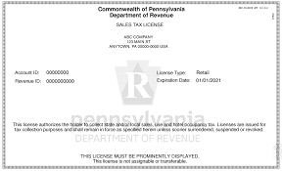
Bulk Sales Compliance
The Bulk Sales Law requires that the Pennsylvania Department of Revenue and the Pennsylvania Department of Labor & Industry be notified in writing 10 days prior to the transfer of 51 percent or more of any real estate.
Specifically, the Bulk Sales Law applies to
All taxpayers subject to Sales and Use Tax;
All taxpayers subject to Employer Withholding Tax; and
All corporations, joint-stock associations, limited partnerships or companies (including limited liability companies, partnerships and sole proprietorships) subject to any of the taxes administered and enforced by the Pennsylvania Department of Revenue.

Slide 41
Specific Accounting for S Corp Tax Year
(b) The parties consent and agree pursuant to IRC §1377(a)(2) to treat the Company’s taxable year 2022 as if it consisted of two taxable years with the first year ending on the date of the Closing, and to file Form 1120S US Income Tax Return and all state and local tax returns on that basis for the taxable year 2022 basis, attaching the Consent, attached hereto as Exhibit 10.3, to be executed by the parties at or before Closing and attached to those returns as appropriate.
Neither of the Sellers shall be allocated for tax purposes or entitled to receive a share of any income generated by the Company after the date of Closing.
The Sellers will responsible for all taxes payable by the Company attributable to income received by the Company prior to Closing, and shall indemnify, defend and hold the Purchaser and the Company harmless of and from any cost, liability, and/or loss incurred by the Purchaser and/or the Company as a result of any taxes payable by the Company prior to the date of Closing, and for the preparation and filing of tax returns for tax years through 2021.

Slide 42

Release
11.1 Release by the Sellers
The Sellers, jointly and severally hereby absolutely and unconditionally releases and forever discharge the Purchaser and the Company, and any and all participants, parent corporations, subsidiary corporations, affiliated corporations, insurers, indemnitors, successors and assigns thereof, together with all of the present and former directors, officers, agents and employees of any of the foregoing, from any and all claims, demands or causes of action of any kind, nature or description, whether arising in law or equity or upon contract or tort or under any state or federal law or otherwise, which the Sellers had now have or have made claim to have against any such person for or by reason of any act, omission, matter, cause or thing whatsoever arising from the beginning of time to and including the date of this Agreement, whether such claims, demands and causes of action are matured or unmatured or known or unknown.

Slide 43
TedPerkinsTax News
Verify Your Attendance
Please type “present” into the chatbox on your screen and hit ENTER.
This is an important step which verifies your attendance and assures that your credit is received.
Thank you.

Slide 44
Allocation of the Purchase Price

Slide 45
A clause like the following should be part of the Agreement”
“1.2 The Purchase Price shall be allocated in accordance with Exhibit 2.5.
1.3 After the Closing, the parties shall make consistent use of the allocation, fair market value and useful lives specified in Exhibit 2.5 for all Tax purposes and in all filings, declarations and reports with the IRS in respect thereof, including the reports required to be filed under Section 1060 of the Code.
1.4 Buyer shall prepare and deliver IRS Form 8594 to Seller within forty-five (45) days after the Closing Date to be filed with the IRS.
1.5 In any Proceeding related to the determination of any Tax, neither Buyer nor Seller or Shareholders shall contend or represent that such allocation is not a correct allocation.”

Slide 46




Seller Bias
S corporations will favor allocations to Assets which produce Capital Gain and
away from Assets which produce Ordinary Income
Goodwill, Capital Assets, Sec 1231 Assets w/o Depreciation Recapture
Inventory, Sec. 1231 Assets which result in Depreciation Recapture, Covenant Not to Compete

Slide 47



Buyer Bias
Inventory, tools and supplies, and employment and consultation agreements.
Items that give rise to a current deduction.
Tangible personal property that is depreciable over a period less than 15 years
All of the intangible assets that are included in the definition of ''Section 197 intangibles'', which are amortizable over a period of 15 years.
Any asset that is depreciable over a period in excess of 15 years.
Land, which gives rise to no amortization or depreciation deduction.
Machinery and Equipment
Goodwill and Going Concern Value
Buildings
Land
Notes:
47

Slide 48


Sec. 1060 Allocation Rules
Class I assets are cash, demand deposits and like accounts.
Class II assets are certificates of deposit, government securities, readily marketable stock or securities.
Class III assets are accounts receivable.
Class IV assets are inventory.
Class V assets are all assets not found in the other six classes, such as furniture, fixtures, equipment, machinery and real property.
Class VI assets are intangible assets, other than goodwill and going concern value.
Class VII assets consist of goodwill and going concern value.

Slide 49

Sec. 197 Intangibles
Goodwill as a personal asset

Slide 50
Reps and Warranties

Slide 51

Representations and Warranties
> A “representation” is a “presentation of fact.. made to induce sooner to act”.
> A “warranty” implies a guarantee.

Slide 52

Purpose of Reps and Warranties
> First, they act as a supplement to actual due diligence.
> Second, the accuracy of the representations and warranties is generally a condition to closing the transaction
> Third, they provide a basis for indemnification if a representation or warranty is false.
Remember the Seller may not exist after
the Sale is Complete

Slide 53
Representations and Warranties of the Seller in an Asset Transaction
4.1. Organization and Good Standing.
4.2. Subsidiaries.
4.3. Title to Properties.
4.4. Tax Matters.
4.5. Litigation.
4.6. Absence of Undisclosed Liabilities
4.7. Financial.
4.8. Absence of Debt
4.9. Absence of Certain Changes and Events.
4.10. Additional Information.
4.11. Restrictions.
4.12. Compliance With Laws.
4.13. Employee Benefit Plans; Employee Relations.
4.14. Authorization;
4.15. Employees.
4.16. Accounts Receivable.
4.17. Inventories.
4.18. Product Warranties.
4.19. Suppliers and Customers
4.20. Environmental.
4.21. Insurance Coverage.
4.22. Disclosure.

Slide 54
Representations and Warranties of the Seller in a Stock Transaction
REPRESENTATIONS AND WARRANTIES REGARDING THE SELLERS
2.01 Organization and Authority.
2.02 Ownership of Acquired Securities
2.03 No Conflicts
2.04 Litigation
2.05 Brokers
2.06 Securities Law Representations
REPRESENTATIONS AND WARRANTIES REGARDING THE COMPANY
3.01 Organization, Qualification and Corporate Power
3.02 Capitalization
3.03 Authority
3.04 Brokers
3.05 Financial Statements
3.06 Absence of Certain Changes
3.07 No Undisclosed Liabilities
3.08 Title to and Sufficiency of Assets
3.09 Tangible Personal Property; Condition of Assets
3.10 Real Property
3.11 Material Contracts
3.12 Intellectual Property
3.13 Tax
3.14 Legal Compliance; Anti-Corruption Laws; Export Control Laws and Economic Sanctions Laws
3.15 Litigation
3.16 Warranties
3.17 Employees
3.18 Employee Benefits
3.19 Customers and Suppliers
3.20 Transactions with Related Persons
3.21 Insurance
3.22 Privacy and Security
3.23 Bank Accounts
3.24 COVID-19.

Slide 55

Knowledge
> Many representations and warranties will be qualified by the “knowledge” of the person making the representation.
>The seller will generally attempt to use knowledge qualifications to limit many of their representations and warranties.

Slide 56

Knowledge
> The agreement should specify just whose knowledge is at issue.
> A clause like the following could be included:
“Phrases such as knowledge mean with respect to the should include phrases known or no knowledge mean with respect either party to this agreement the actual knowledge such parties executive officers.”

Slide 57

Survival
> One the primary purposes of the representation clauses is to provide a basis for enforcing Indemnification provisions.
>Therefore, a survival provision is also necessary

Slide 58

Bring Down
In all cases it is not sufficient that the representations be made at the time of the execution agreement they must also be accurate as of date of closing.
The requirement that the representations be accurate on the date of closing is referred to as the “bring-down.”

Slide 59
TedPerkinsTax News
Verify Your Attendance
Please type “present” into the chatbox on your screen and hit ENTER.
This is an important step which verifies your attendance and assures that your credit is received.
Thank you.

Slide 60
Covenants

Slide 61

Covenants of the Seller
Often the Agreement will provide covenants of the Seller ...
…to govern activity between conduct of the parties between the date of the execution of the Agreement and the Closing Date.

Slide 62
The following are examples of those covenants -
Seller will not sell, pledge, convey, transfer or encumber or enter into any agreement for the transfer or sale of the Seller or any of the Assets, other than in the ordinary course of the business.
Seller will conduct the Business in its usual and customary manner.
Seller will not enter into any contract or commitment, incur any liability or engage in any transaction relating to the Business requiring an expenditure in excess of $10,000, other than in the ordinary course of the business.
Seller will notify Purchaser promptly in writing of any claim, lawsuit, action or proceeding that may be asserted, commenced or threatened.
From and after the date of this Agreement, Seller shall give Purchaser, its counsel, accountants and other representatives full access during Seller’s normal business hours, subject to reasonable security measures and reasonable prior notice, to all of the Assets and all books, records, agreements and commitments relating to the Business,
Seller will comply with all material applicable laws, rules and regulations of any governmental entity, agency or instrumentality relating to the Business.
Promptly after the Closing, Seller shall amend its certificate of incorporation to change its name to a name which is not confusingly similar to “Beta, Inc.”

Slide 63
Conditions Precedent

Slide 64

What does the Buyer need to happen…
Financing
Due Diligence/Inspection
Contracts transferred
Secure the location
Transfer of specific strategic asset (e.g., liquor license )
Retention of a Key Employee
Condition and suitability of the assets acquired
Third Party consent (e.g., franchise transfer)

Slide 65
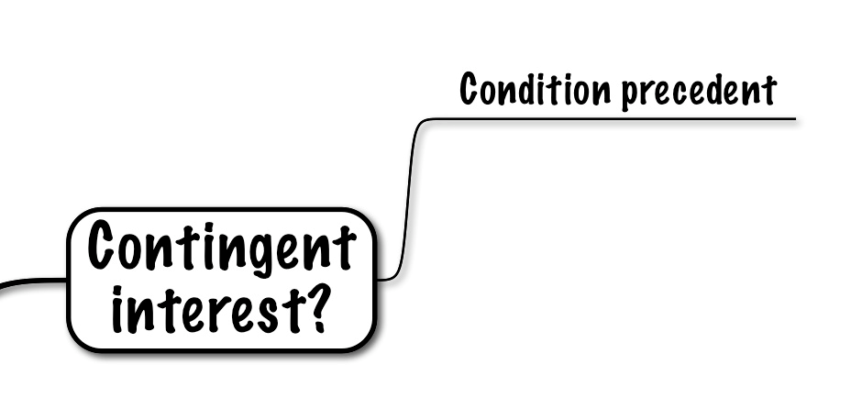
Condition Precedent to the Obligations of the Seller
Before the Seller is finally legally bound to compete the transactions should be condition on the following:
The Consideration has been delivered
All required documents have been delivered
The representation of the Buyer accurate as of the Closing Date
All covenants have been performed by the Seller

Slide 66
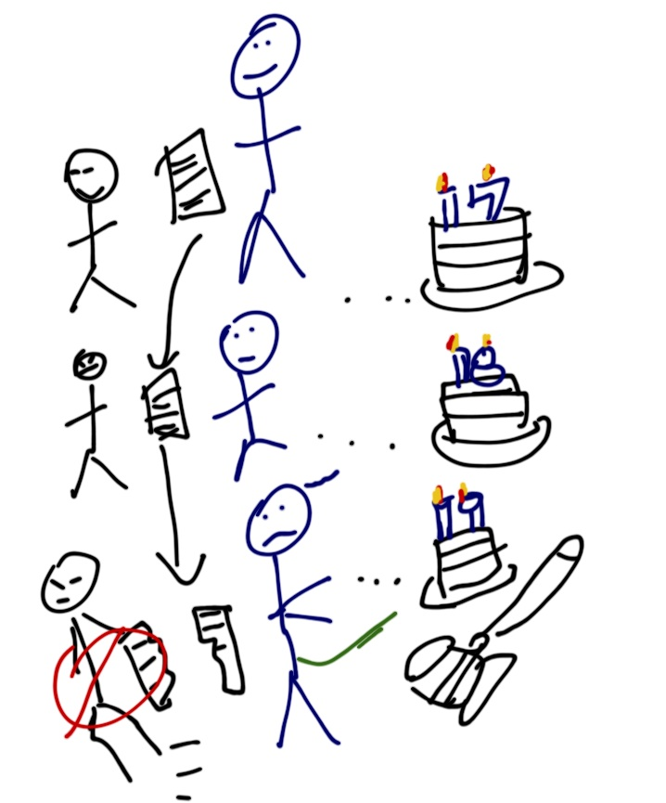
Waiver
> Always include a waiver clause which allows the complying party to waive a condition
>This will prevent the non-complying party from using their own non-compliance as an excuse not to complete the transaction.

Slide 67
TedPerkinsTax News
Verify Your Attendance
Please type “present” into the chatbox on your screen and hit ENTER.
This is an important step which verifies your attendance and assures that your credit is received.
Thank you.

Slide 68
Closing

Slide 69

Closing
>The provisions dealing with the Closing should provide the date and location of the Closing and the items which each party will be expected to deliver.
>The provision in certain cases will also provide the allocation of costs between the Buyer and the Seller.
> The provision should also provide the documents to be delivered by both parties

Slide 70
Closing Deliveries of the Seller
7.1 Closing Deliveries. Effective as of the Closing, Seller and Shareholders shall have executed (where applicable) and delivered to Purchaser each of the following, together with any additional items that Purchaser may reasonably request to effect the transactions contemplated herein:
(a) Possession of the Purchased Assets;
(b a Bill of Sale
(c) an Assignment and Assumption Agreement
a copy, certified by Seller’s secretary, of the resolutions of the board of directors of Seller and Shareholders
the Offer of Employment
(f) the New Lease, duly executed by landlord;
the Noncompetition Agreement
payoff letters from each creditor of Seller
a good standing certificate for Seller,
(j) any and all usernames, passwords, keys and/or codes
(k) any other documents or agreements reasonably requested by Purchaser to carry out the transactions contemplated by this Agreement.

Slide 71
Closing Deliveries of the Buyer
8.1 Closing Deliveries. Effective as of Closing, Purchaser or its Affiliates shall have delivered to Seller each of the following, together with any additional items which Seller may reasonably request to effect the transactions contemplated herein:
(a) the Closing Cash Payment;
(b) the Offer of Employment, duly executed by Purchaser;
(c) the New Lease, duly executed by Purchaser;
(d) the Noncompetition Agreement, duly executed by Purchaser;
(e) the Assignment Agreement, duly executed by Purchaser; and
(f) any other documents or agreements contemplated hereby.

Slide 72
Resolutions and Other Documents

Slide 73
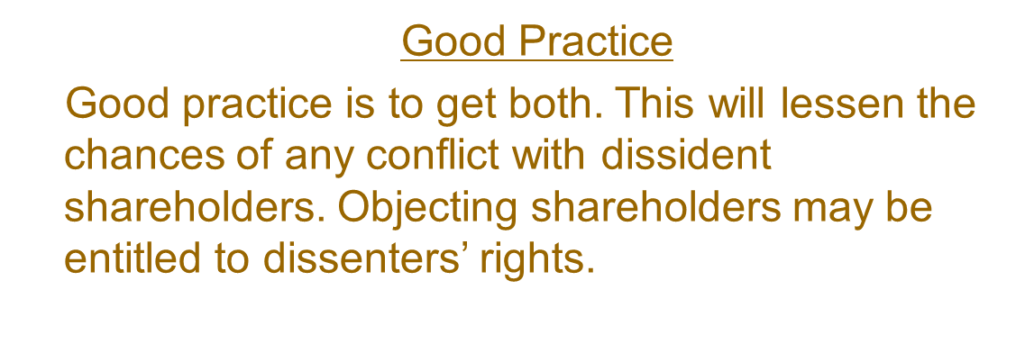

Resolutions and Required Approvals
Approval of the Board of Directors and/or the Shareholders
Look to state law and the corporate governance documents in order to determine the whether the transaction requires approval of the Board and/or the Shareholders

Slide 74
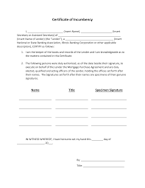
Incumbency Certificate
Purchaser shall have received such certificates or other documentation from Sellers as reasonably requested by Purchaser certifying to the appropriate authorizations for the execution, delivery and performance of this Agreement by, and the incumbency of persons executing this Agreement on behalf of, those Sellers that shall be corporations or trusts or partnerships.

Slide 75
Indemnity

Slide 76

Seller’s Indemnity
- Indemnification Clauses are generally intended to provide the Buyer recourse for misrepresentations and acts of the Seller
- In order to ensure that Buyer will have recourse negotiate a Hold Back clause
A deferred payment promissory note can also serve the same purpose
Also, the Agreement should provide that the Seller’s representations and warranties survive the Closing

Slide 77

Buyer’s Indemnity Clause
- Indemnification may also provide the Seller recourse in the event that the Buyer’s post-Closing operation of the acquired operation results in Claims to the Seller
- In addition, the Seller may seek indemnification if the Buyer fails to fulfill post-Closing covenants such as assumption of debt.

Slide 78

Reps and Warranty Insurance
Representations and warranties insurance is an insurance policy used in mergers and acquisitions to protect against losses arising due to the seller’s breach of certain of its representations in the acquisition agreement.

Slide 79

Escrows and Holdbacks
(b) Holdback. At the Closing, Four Hundred Seventy Thousand and No/100 Dollars ($470,000) of the Purchase Price will be retained by Purchaser for the one (1) year period following the Closing Date as a non-exclusive source of funds to satisfy Seller’s payment obligations under the Agreement, including, without limitation, any amounts owed pursuant to Sections 2.4 and 2.5 hereof and any indemnification claims made by any Purchaser Indemnitee (the “Holdback”). The remaining amount, if any, of the Holdback, less the amount of any then threatened or pending claims against the same, shall be released to Seller upon the later of (i) thirty (30) days after the first anniversary of the Closing

Slide 80
Tail Policies and D&O Indemnification
Following the Closing and for a period of six (6) years, Buyer shall, and shall cause the Company to, maintain the D&O Tail Policy in full force and effect and, subject to any limitations under applicable Law, use commercially reasonable efforts to continue to honor the obligations of the Company with respect to any indemnification provisions under the Organizational Documents of the Company (as in effect on the date of this Agreement) and any indemnification Contracts between the Company, on one hand, and any such directors or officers of the Company, on the other hand, in each case in effect as of the date hereof and only if such Contracts are set forth on Schedule 5.11, with respect to their acts or omissions occurring prior to the Effective Time; provided, that any Losses of the Company related to such indemnification or enforcement of the D&O Tail Policy shall constitute indemnifiable Losses of the Buyer under Article VIII;

Slide 81
TedPerkinsTax News
Verify Your Attendance
Please type “present” into the chatbox on your screen and hit ENTER.
This is an important step which verifies your attendance and assures that your credit is received.
Thank you.

Slide 82
Post Closing Covenants

Slide 83
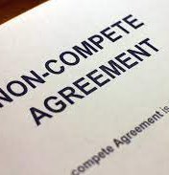
Covenant Not to Compete
Pennsylvania courts are most likely to enforce post-employment restrictive covenants when
Supported by adequate consideration;
(3) Reasonably necessary to protect a legitimate business interest; and
(4) Limited in both time and territory.

Slide 84

Non-Solicitation Agreement
Non-solicitation agreements prevent an employee from persuading customers and
suppliers to end their relationship with the employer and join him or her with a rival competitor or new start-up company.
Unlike non-competition agreements, non-solicitation agreements do not directly prevent the employee from working for a rival competitor or starting his or her own
business.
In states that have presumptively banned non-competition agreements, such as
California, non-solicitation agreements might still be enforced as an alternative to protect an employer's legitimate interests.

Slide 85

Non- Disclosure Agreement
Non-disclosure agreements, also known as confidentiality agreements, are used to prevent employees from exposing trade secrets and other confidential information obtained during the course of employment to third-parties after the employment relationship ends.
Although Pennsylvania courts agree that employees owe a fiduciary duty to employers to keep sensitive information learned through employment in confidence, Lorman v. Lieb, 37 Pa. D. &C.2d 305, 312-313 (Cam.Pa.Com.Pl. 1965), a non-disclosure agreement further informs the court that the employer had an express legitimate business interest in protecting certain information.
Generally, however, an employer will only be able to protect such information that is not easily accessible to the public. Also, employees might be able to defeat a non-disclosure agreement by proving that the trade secret or confidential information was developed or learned prior to the employment relationship.

Slide 86
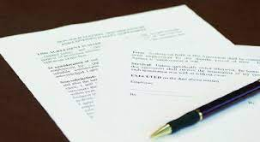
Non-Solicitation Agreement
Finally, non-solicitation agreements are drafted to prevent an employee from soliciting other employees to join a rival competitor or newly established business.
Pennsylvania recognizes a tort, intentional interference with contract relations, which may allow for employers to file suit on other companies and/or former employees for "raiding" their talent base.
Adding a non-solicitation agreement may strengthen such a cause of action.

Slide 87
Miscellaneous

Slide 88

Miscellaneous Clauses
Other provisions in the Agreement to be included are the following:
1. Amendments
2. Allocation of expenses
3. Notices
4. Entire Agreement
5. Assignability
6. Governing law
7. Severability

Slide 89
The End

Slide 90
COURSE EVALUATION
Thank you for attending our program.
Your Web browser will now direct you to a page with a Course Evaluation form.
Please do not close your browser until you have completed this form, which helps us comply with the requirements of issuing CPE and CLE in various jurisdictions.

