Slide 1
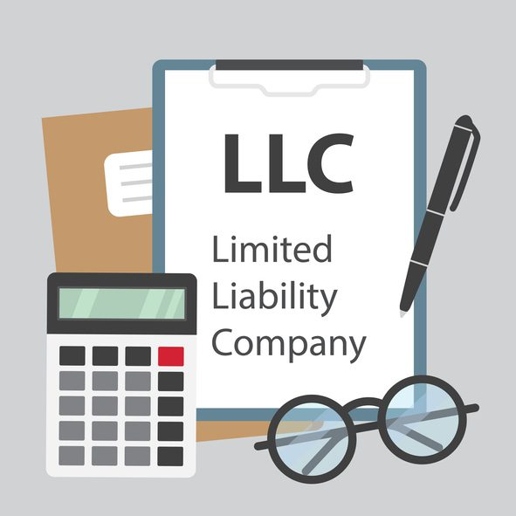
Forming an LLC
in Pennsylvania
A comprehensive overview of key issues in LLC formation, management, taxation, and governance

Slide 2

EDWARD L. PERKINS, BA, JD, LLM(Tax), CPA
Founding Shareholder - Gibson & Perkins, PC
tedperkins@gibperk.com
610.565.1708 ext. 102
Adjunct Professor
Villanova University School of Law - Graduate Tax Program
Author
AICPA’s – Taxation of Trusts and Estates
AICPA’s – Fundamentals of Trusts
Drafting Wills That Work in Pennsylvania
PBI - Special Needs Trusts in Pennsylvania
PBI - The Pennsylvania Trusts Handbook
PBI - The ABCs of Will Contests – Co-Author Paul Fellman
Founder - YourOnlineProfessor.net

Slide 3
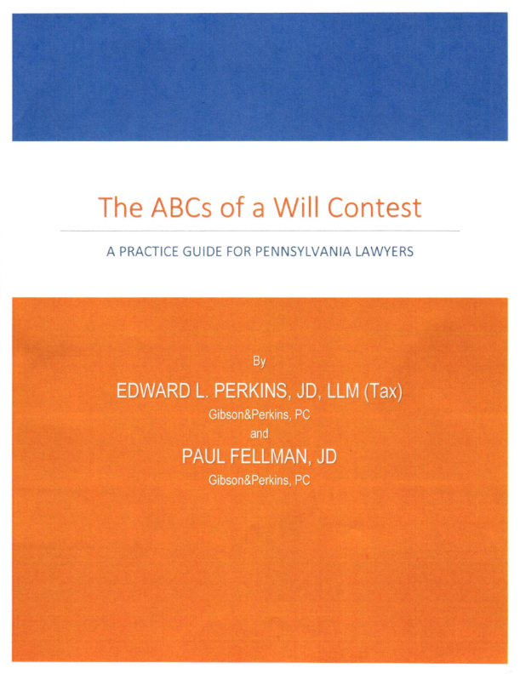
NOW AVAILABLE at PBI.org
Publications and Media/
Press Books
https://www.pbi.org/catalog?category=PBI-Press-Book

Slide 4

MARTIN J. PEZZNER, BS, JD, CPA
Gibson & Perkins, PC
mpezzner@gibperk.com
610.565.1708 ext. 112
Mr. Pezzner has a wealth of experience as a practicing attorney for over twenty-nine years. After graduating Wilkes College with a Bachelor of Science in accounting, he was employed by the Internal Revenue Service in Philadelphia, PA as a Tax Revenue Agent (Field Agent) for five years. He also worked for one year in the Philadelphia IRS Appeals Office. While employed by the IRS, he became a CPA (1985) in the Commonwealth of Pennsylvania. Mr. Pezzner received his Juris Doctorate Degree from the University of Dayton School of Law in 1989.
Mr. Pezzner is admitted to practice in the Commonwealth of Pennsylvania and the Eastern District of Pennsylvania. Well-versed in all aspects of law, he is especially knowledgeable in the realms of Estate Administration, Estate Planning, Business Matters, and Tax Controversies.
He is a member of the Philadelphia Bar Association and the Probate and Trust Law Section of the Philadelphia Bar. He also maintains his CPA license.

Slide 5

Suite 204
100 W Sixth Street
Media, PA 19063
610 565 1708
www.gibperk.com
www.youronlineprofessor.net

Slide 6
GIBSON&PERKINS, PC is a multi-practice law firm with offices in Pennsylvania and Delaware. Our firm has expanded from its founding in 2001, into a vibrant and growing law firm dedicated to serving an ever expanding and sophisticated client base.
We represent clients in matters pertaining to:
Business Transactions
Real Estate
Estate Planning
Estate Administration
Tax Problem Resolution
Emerging Businesses
Litigation

Slide 7
YourOnLineProfessor.net
CLE - Continuing Legal Education for
Attorneys:
YourOnlineProfessor.net is an Accredited Provider for Pennsylvania Continuing Legal Education, through The Supreme Court of Pennsylvania's Continuing Legal Education Board, registered as sponsor #7003.
This program qualifies as 1 hour - ‘Live Webcast’ under PA CLE Board guidelines and in the states of Delaware, New Jersey, California, and Texas
In most cases, credit is also available to New York attorneys through New York’s “approved jurisdiction policy.”

Slide 8
YourOnLineProfessor.net
CPE - Continuing Professional Education for
CPAs:
YourOnlineProfessor.net is registered with the Pennsylvania Department of State's Bureau of Professional and Occupational Affairs as a Program Sponsor under the State Board of Accountancy. Our license number is PX177605.
This Course will count as 1.0 Hour of Group Internet Based or
Interactive Self Study Credit depending on how you access the Course.
For CPAs taking an archived version of the Course for Interactive Self Study Credit successful completion of a Final Examination is required. The Final Slide will direct you as to how to access and complete the Final Examination.

Slide 9
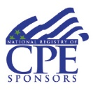
NASBA Registry of CPE Sponsors
YourOnlineProfessor.net is registered with the National Association of State Boards of Accountancy (NASBA) as a sponsor of continuing professional education on the National Registry of CPE Sponsors. State boards of accountancy have final authority on the acceptance of individual courses for CPE credit. Complaints regarding registered sponsors may be submitted to the National Registry of CPE Sponsors through its website: www.learningmarket.org.
Our Sponsor No. Identification Number 137573

Slide 10
Refund Policy
It is the policy of YourOnlineProfessor.net to satisfy participants and purchasers in a reasonable manner. Therefore, refunds to dissatisfied participants will be given in order to maintain good will. However, the reason for a participant's dissatisfaction and any resulting refund must be clearly indicated. Each refund request will be reviewed by a majority of the members of YourOnlineProfessor.net. A refund is always given if a course does not qualify for CPE credit in the state in which the purchaser seeks to apply it for credit.
Program Cancellation Policy
It is the policy of YourOnlineProfessor.net to refund any fees paid in full in the event that a scheduled program is cancelled or rescheduled.
Complaint Resolution Policy
All evaluations are reviewed by Edward Perkins. Grievance complaints are directed to Mr. Perkins at (610) 565-1708 ext. 2 or via email to yop@youronlineprofessor.org. It is the policy of YourOnlineProfessor.net to respond to every grievance complaint. This response shall include when appropriate: reviewing the grievance complaint in conjunction with other participant evaluations and discussion of the grievance complaint with the course instructor or other employees.

Slide 11
Where Applicable, this program is
© YourOnlineProfessor.net - All Rights Reserved.
This material is designed for informational purposes. In providing this material, neither the author nor YourOnlineProfessor.net are engaged in rendering legal, accounting or professional service. If legal, accounting, or professional service is required, the service of a competent professional should be sought.
Inquiries regarding the use of the material contained in
this Course should be addressed to:
Ted Perkins
tperkins@gibperk.com
Suite 204
100 W. Sixth Street
Media, PA 19063

Slide 12

Attendees will be asked to periodically verify their attendance
in order to comply with CPE/CLE guidelines.
This involves clicking “Still here” when the pop-up arises.
It is important that you follow all such prompts
in order to ensure that your CPE/CLE credits
are received in full.

Slide 13
Technical Support
If you have issues during the presentation, please email
stait@gibperk.com
for real-time troubleshooting assistance.

Slide 14
Questions
If you have any questions regarding this Course please contact
Martin Pezzner
at mpezzner@gibperk.com
or
Ted Perkins
at tperkins@gibperk.com
or
(610) 565-1708 Ext. 104

Slide 15
Forming an LLC
in Pennsylvania
A comprehensive overview of key issues in LLC formation, management, taxation, and governance

Slide 16
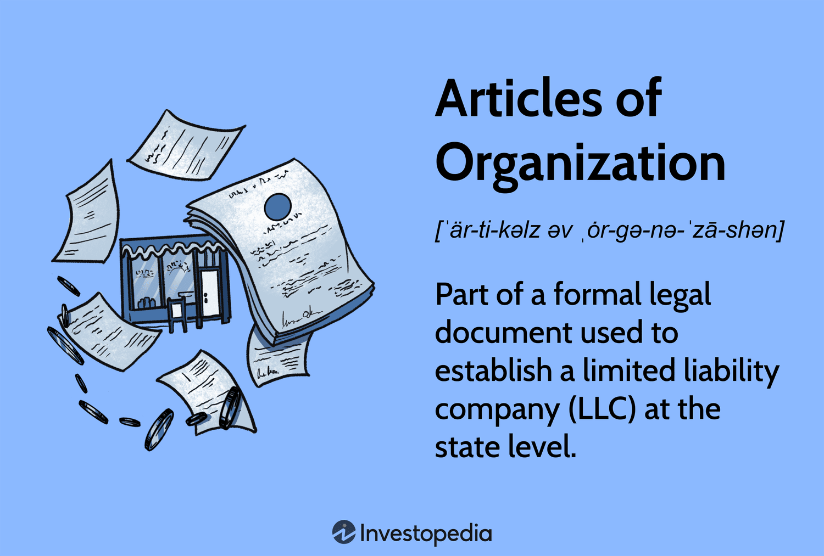
Organization
Jurisdiction • Formation Requirements • Taxation • Annual Requirements

Slide 17

Jurisdiction

Slide 18

Organization: Jurisdiction
1. Overview
This is a question that comes up constantly in business planning, and the honest answer is: for most small to mid-sized businesses, your home state is the best choice.
The idea that Delaware, Wyoming, or Nevada is universally superior is largely a myth and, in many cases, forming in another state actually increases cost and complexity without meaningful benefit.
2. The Core Principle: Foreign Registration
If you form an LLC in Delaware but operate your business in Pennsylvania, you will still need to register as a "foreign LLC" in Pennsylvania, pay Pennsylvania fees, maintain a Pennsylvania registered agent, and comply with Pennsylvania law for tax and regulatory purposes.
You end up paying for two states instead of one.
For most small businesses, this makes out-of-state formation a net negative.

Slide 19
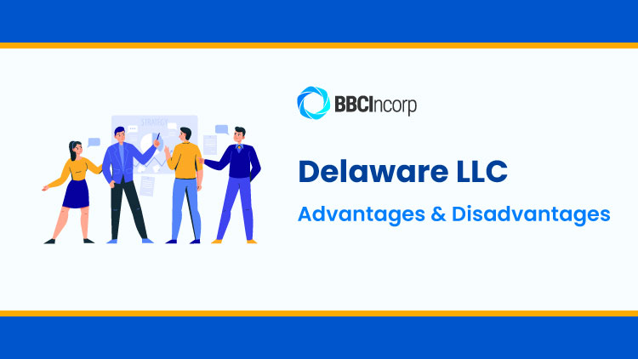
Jurisdictions - Other Jurisdictions
DELAWARE: BEST FOR VENTURE-BACKED OR INSTITUTIONAL BUSINESSES
Delaware is the gold standard for businesses that anticipate venture capital investment, private equity, institutional financing, or an eventual IPO. Its advantages are real but specific.
POSITIVES
The Delaware Court of Chancery is a specialized business court with no jury trials, highly predictable outcomes, and an enormous body of case law on corporate and LLC governance.
Delaware operates under the “freedom of contract” principle
Delaware also has no state income tax on income earned outside Delaware, though this rarely benefits a small operating business.
NEGATIVES
The downside is everything described above - cost, foreign registration, and complexity.

Slide 20
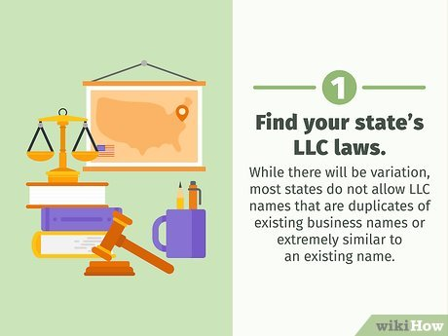
Nevada, Wyoming, & Other States
Nevada & Wyoming
Privacy, asset protection, and no state income tax are the positives
The same foreign registration problem applies.
Nevada has higher annual fees than Wyoming.
For most Pennsylvania-based businesses, Nevada offers little that Wyoming doesn't, and Wyoming is generally cheaper.
Other Jurisdictions Worth Noting
A few other states have developed reputations for specific niches. South Dakota has strong trust and asset protection laws.
Florida has no state income tax and is favorable for certain real estate structures.
But again, none of these advantages typically justify the foreign registration burden for a Pennsylvania operating business.

Slide 21

When Out-of-State Makes Sense
There are legitimate reasons to form outside Pennsylvania, including:
When venture capital or institutional investors require Delaware formation,
When you have significant asset protection concerns,
When you have significant privacy concerns.

Slide 22
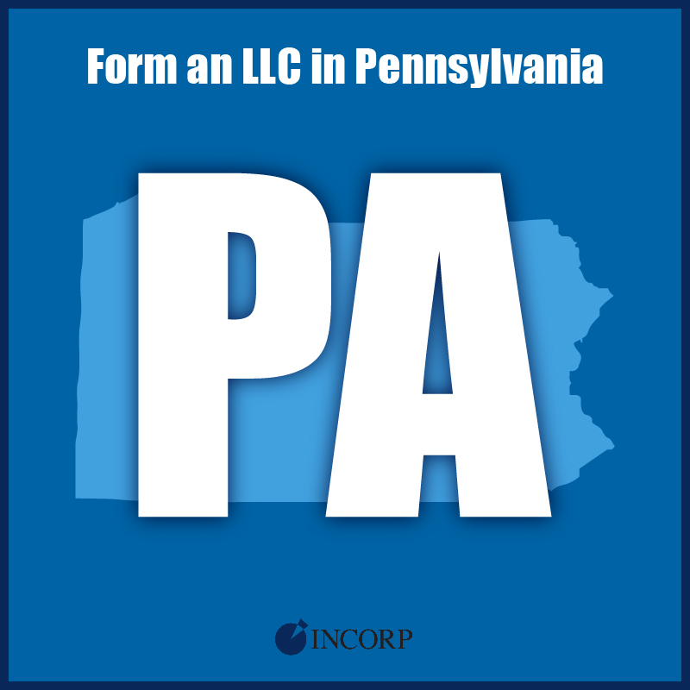
Jurisdiction: Bottom Line
For the overwhelming majority of Pennsylvania small business owners, forming in Pennsylvania is simpler, cheaper, and just as protective as forming elsewhere.
The appeal of Delaware, Wyoming, or Nevada is real in specific contexts, but those contexts are narrower than popular business advice suggests.
In most cases, the best choice is to stay home.

Slide 23



Formation Requirements

Slide 24
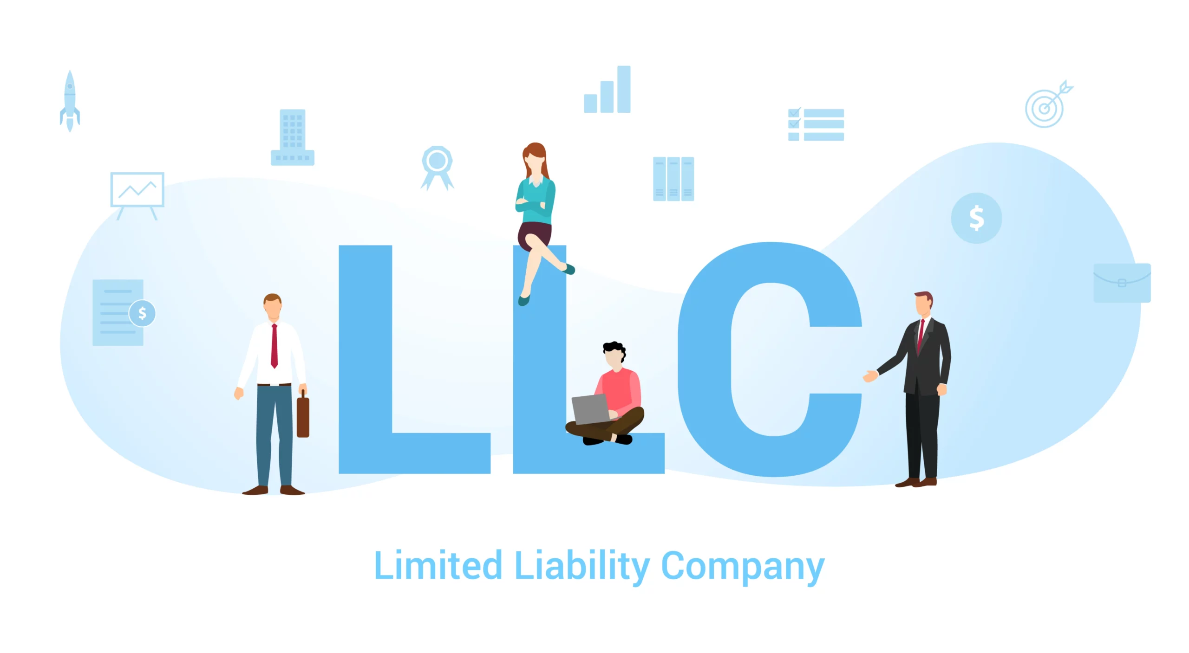
Formation Requirements
1. Certificate of Organization
You must file a Certificate of Organization with the Pennsylvania Department of State and pay the filing fee (currently $125, though this can change).
The certificate must include the LLC's name, its registered office address, and the name of its registered agent.
2. Name Selection
The name must include "Limited Liability Company," "LLC," or "L.L.C." and must be distinguishable from other entities already registered in Pennsylvania.
You can check name availability through the Department of State's business name search.

Slide 25
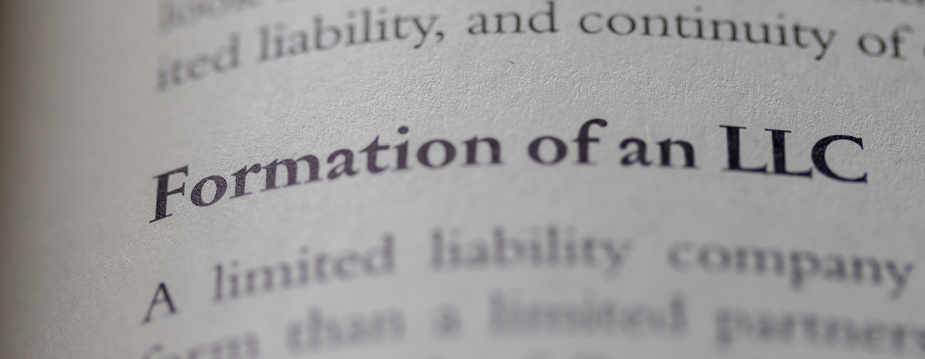

  3. Operating Agreement
  While not required to be filed with the state, an operating agreement is highly advisable.
  It governs ownership percentages, management structure, profit and loss allocation, voting rights, member admission and withdrawal, and dissolution procedures.
Without one, Pennsylvania's default LLC statute rules will apply, which may not reflect the members' actual intentions.
  Management Structure
  Pennsylvania LLCs can be member-managed (all members participate in management) or manager-managed (designated managers run the company).
This should be clearly specified in the operating agreement.
5. Registered Office
You must designate and maintain a registered office with a physical Pennsylvania address to receive legal and official correspondence.
A foreign LLC must have a registered agent in the state, this can be a member, an employee, or a professional registered agent service.

Slide 26

Please click “still here” when the pop-up arises.
This is an important step which verifies your attendance and assures that your credit is received.
Thank you.

Slide 27

Taxation

Slide 28

Taxation: Check-the-Box
"Check the Box" rules:
Before check-the-box, the IRS used a cumbersome multi-factor test to determine whether an entity was taxed as a corporation or a partnership.
The 1997 regulations replaced that with a straightforward elective system.
Basic Framework
They give LLCs a degree of tax flexibility that no other business entity type enjoys.
Under the basic rules, certain LLCs can simply choose to be taxed as a C Corporation by filing IRS Form 8832 or choose to be taxed as an S Corporation by filing IRS Form 2553.

Slide 29
Taxation:
Check-the-Box Framework
The Default Rules
If an LLC does nothing and makes no election, the default classification applies:
A single-member LLC is treated as a “disregarded entity.”
If the owner is a corporation, the LLC's activity is simply folded into the corporate return.
A multi-member LLC is treated as a partnership by default.
These defaults take effect automatically without any filing.

Slide 30

Check-the-Box
The Election is Available
An LLC can affirmatively elect out of its default classification.
Specifically:
A single-member LLC can elect to be taxed as a C corporation or as an S corporation.
A multi-member LLC can elect to be taxed:
As a C corporation or,
if it meets eligibility requirements, as an S corporation.

Slide 31

Check-the-Box: Elections, Practical Consequences & Timing
The Timing Rules
An entity's initial classification election is generally effective from the date of formation if filed within 75 days.
State Tax - Pennsylvania generally follows the federal treatment for pass-through entities
The Bottom Line
The check-the-box rules effectively made the LLC the most tax-flexible business entity in the United States.
An LLC can be whatever it needs to be for tax purposes, while remaining an LLC for state-law purposes.

Slide 32


Employment & Licensing: Annual

Slide 33
Employment & Licensing: Annual Requirements
Employment and Licensing
Depending on your business type, you may need an EIN from the IRS, state and local business licenses or permits, professional licenses, and sales tax registration with the Pennsylvania Department of Revenue.
Annual Requirements
Pennsylvania is a recent convert on this, as it didn't require annual reports from LLCs for a long time, but that changed.
The Annual Report (Form DSCB:15-146) is a relatively new requirement.
Pennsylvania used to require only a decennial (every 10 years) report but Act 122 of 2022 replaced that with an annual filing beginning January 1, 2025.
Deadline for LLCs: January 1 – September 30 of each year. How to file: Online at file.dos.pa.gov.

Slide 34
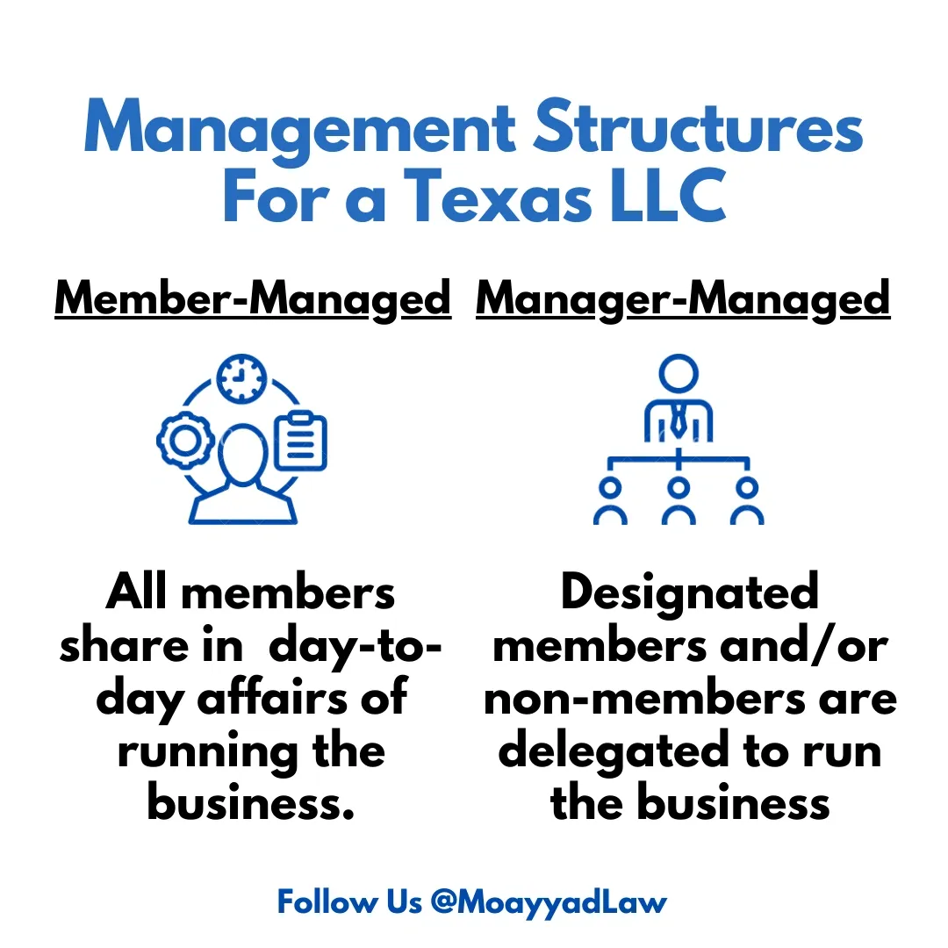
Member v. Manager Managed
Choosing the right governance structure for your LLC

Slide 35

Member-Managed LLC

Slide 36

Member Managed: Overview
Overview
A member-managed LLC is the default structure in Pennsylvania, where all members participate directly in running the business.

Slide 37
Member Managed: Positives
Control and Autonomy
Every member has a direct voice in day-to-day decisions and the strategic direction of the company.
Simplicity
There's no need to appoint separate managers, define the scope of their authority, or create additional layers of governance.
Cost
You avoid the expense of hiring or compensating outside managers, which matters especially in early-stage or small companies.

Slide 38
Member Managed: Negatives
Apparent Authority Risk
In a member-managed LLC, any member can bind the company to contracts or obligations under Pennsylvania's agency principles, even without the other members' consent.
A single member acting alone can create liability for the entire company.
Decision-Making Friction
As the number of members grows, reaching consensus becomes harder and slower.
Disagreements among members can paralyze operations, especially if the operating agreement doesn't include clear tie-breaking or voting mechanisms.
Not Ideal for Passive Investors
If some members are purely investors and don't want to be involved in operations, a member-managed structure either forces their involvement or creates awkward dynamics.

Slide 39

Member Managed - Negatives
Management Competency
Not every member may have the skills or temperament to manage a business.
A member-managed structure doesn't allow you to easily hand authority to the most capable person without restructuring.
Scalability
As the business grows and complexity increases, a flat member-managed structure can become unwieldy.
Companies that anticipate significant growth or outside investment often find manager-managed structures easier to adapt.

Slide 40
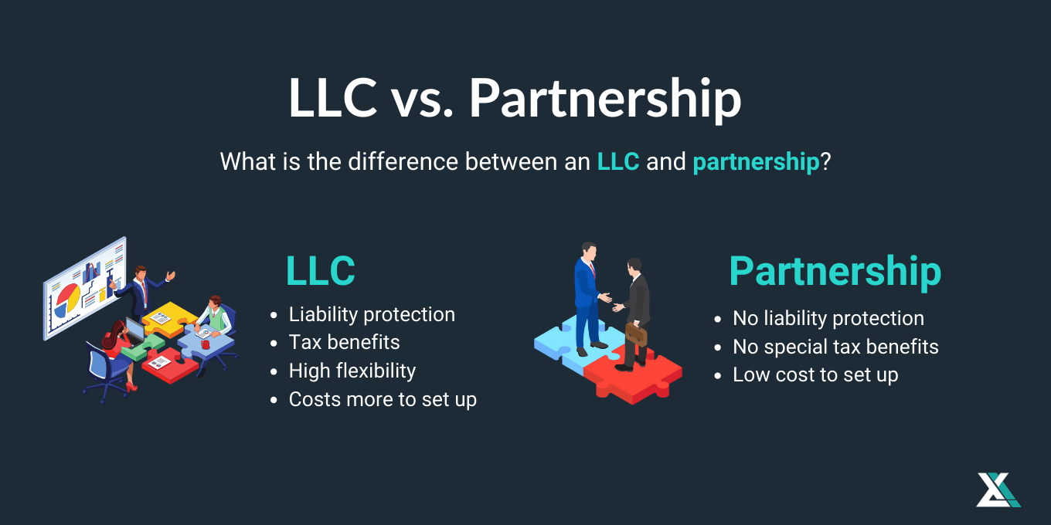
The Bottom Line
Member-managed works best when the LLC has a small number of members who all intend to be actively involved and trust one another's judgment.
As membership grows, becomes more passive, or involves outside capital, the limitations of this structure tend to outweigh the simplicity it offers.
A well-drafted operating agreement can mitigate many of the negatives, particularly by limiting the authority of individual members to act unilaterally.

Slide 41

Manager-Managed LLC

Slide 42
Overview
A manager-managed LLC is one where authority is vested in one or more designated managers, who may or may not be members, rather than in all members collectively.
Better for Passive Investors
Members who contribute capital but don't want operational involvement can remain hands-off.
This makes the structure attractive for raising outside investment and accommodating silent partners.
Manager Managed: Overview

Slide 43

Manager Managed: Positives
Controlled Authority
Only the designated manager or managers have the power to bind the company to contracts and obligations.
Professional Management
You can appoint someone with specialized expertise to run the company even if they have little or no ownership stake.
This separates management competency from capital contribution.

Slide 44

Manager Managed: Positives
Scalability
As the business grows and the number of members increases, a manager-managed structure scales more naturally.
It resembles a corporate governance model, which is familiar to investors and lenders and easier to adapt as complexity grows.
When members are genuinely passive and a manager runs the business, the arrangement more clearly separates investment from management.

Slide 45

Manager Managed: Negatives
Loss of Direct Control for Members
Non-managing members give up day-to-day decision-making power.
If they disagree with how the manager is running things, their recourse is typically limited to whatever removal and voting rights are spelled out in the operating agreement.
Potential for Conflict
Tensions can arise between managers and non-managing members, especially if the members feel excluded from information or believe the manager is not acting in the LLC's best interests.
A poorly drafted operating agreement can leave members with little practical recourse.
Complexity and Cost
The governance structure requires more careful drafting of the operating agreement, defining the manager's authority, limits on that authority, fiduciary duties, compensation, removal procedures, and member voting rights.
This means more upfront legal cost.

Slide 46

Manager Managed: Negatives
Fiduciary Duty Obligations
Under Pennsylvania law, managers owe fiduciary duties to the LLC and its members.
If a manager acts in self-interest or mismanages the company, members may have legal claims, but litigation is expensive and disruptive, and it underscores the importance of choosing a trustworthy manager.
Information Asymmetry
Non-managing members may find themselves at an informational disadvantage, relying on whatever reporting the manager chooses to provide unless the operating agreement mandates specific disclosures and reporting obligations.
Manager Removal Can Be Complicated
If a manager is performing poorly or acting improperly, removing them depends entirely on the terms of the operating agreement.
Without clear removal provisions, members may find themselves stuck with a manager they no longer want.

Slide 47

The Bottom Line
Manager-managed is generally the better choice when:
  The LLC has passive investors,
  A larger or more diverse membership, or
  When the best person to run the business is not necessarily an equal owner.
The tradeoff is a more complex governance structure that demands a thorough, carefully negotiated operating agreement.
The quality of that document will largely determine how well the structure functions in practice.

Slide 48
Please click “still here” when the pop-up arises.
This is an important step which verifies your attendance and assures that your credit is received.
Thank you.

Slide 49

Taxation
Partnership Election • S Corporation • Self-Employment Tax

Slide 50

Partnership
Partnership Election • S Corporation • Self-Employment Tax

Slide 51

Partnership Election: Overview
LLCs are treated as partnerships by default for federal tax purposes …
…there are meaningful advantages and drawbacks to consider, particularly in Pennsylvania's tax environment.

Slide 52
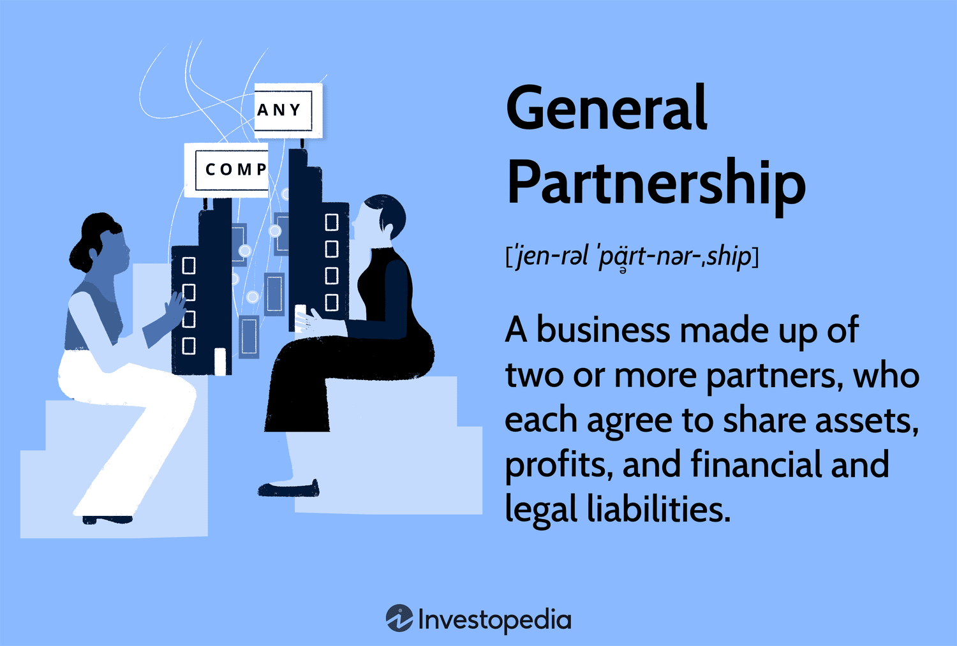
Partnership Election: Positives
Pass-Through Taxation
The LLC itself does not pay federal income tax.
Income and losses flow through to the members, who report them on their individual returns.
Loss Deductibility
Members can generally deduct their share of LLC losses against other income (subject to basis, at-risk, and passive activity rules).

Slide 53
Partnership Election: Overview & Positives
Flexibility in Profit and Loss Allocation
Unlike S-corporations, which must allocate income strictly in proportion to ownership, partnerships can use "special allocations" to distribute income, losses, deductions, and credits in ways that don't match ownership percentages, as long as the allocations have substantial economic effect under IRS rules.
This gives members significant flexibility in structuring their economic arrangement.

Slide 54
Pennsylvania generally follows federal partnership tax treatment for pass-through entities, so the structure avoids navigating a large gap between state and federal treatment
Partnership Election: Overview & Positives

Slide 55
Partnership Election: Negatives
Self-Employment Tax
Members who are active in the business are generally subject to self-employment tax (15.3% on the first tier, 2.9% above that) on their distributive share of income.

Slide 56
Partnership Election The Bottom Line
Partnership tax treatment is often the right default for LLCs with passive investors, those holding appreciating assets, or those in early stages with expected losses.
However, for active owner-operators generating significant profit, the self-employment tax burden can outweigh the simplicity benefits, making an S-corporation election worth serious consideration.

Slide 57

When Self-Employment Tax Does Not Apply
The General Rule
Active members of a partnership-taxed LLC who participate in the business are subject to self-employment tax on their distributive share of income.
This mirrors the treatment of general partners under IRC Section 1402, which is the foundational provision governing self-employment tax for pass-through entities.
Passive Members: The Limited Partner Analogy
The most well-established exception is for members who are the functional equivalent of limited partners.
Under IRC Section 1402(a)(13), a limited partner's distributive share of partnership income is excluded from self-employment tax, only guaranteed payments for services are included.
The IRS and courts have extended this analysis to LLC members, asking whether a member's role is functionally equivalent to that of a limited partner.

Slide 58
When Self-Employment Tax Does Not Apply
Rental Income
Investment Income
Guaranteed Payments for the Use of Capital
Members With No Active Role in a Manager-Managed LLC
The Net Investment Income Tax Consideration

Slide 59
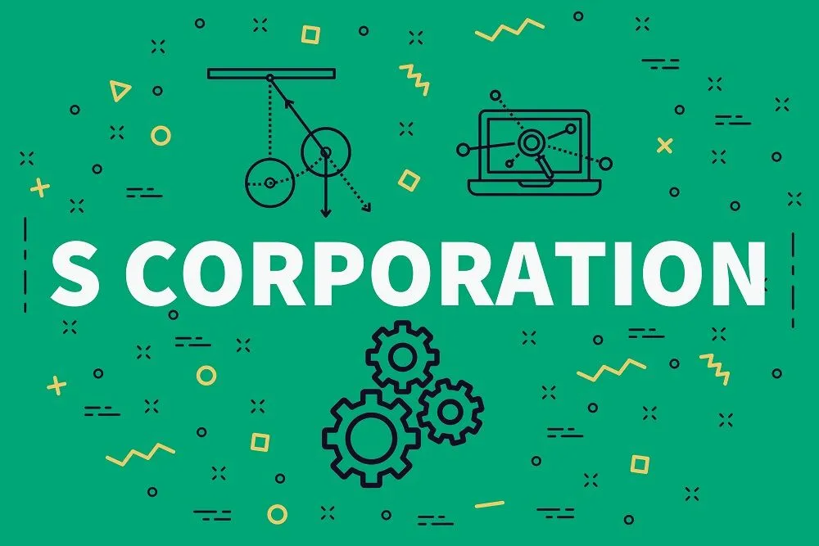
S Corporation
Partnership Election • S Corporation • Self-Employment Tax

Slide 60

S Corporation: Overview
Electing S-corporation status for a Pennsylvania LLC done by filing IRS Form 2553
It combines the liability protection and operational flexibility of an LLC with certain tax advantages of S-corporation treatment.
The tradeoffs, however, are significant.

Slide 61
Self-Employment Tax Savings. This is the primary driver for most S-corp elections. Under S-corp treatment, only the wages paid to owner-employees are subject to FICA taxes (Social Security and Medicare).
The remaining profits distributed to members as distributions are not subject to self-employment tax. For a profitable business, this can generate thousands of dollars in annual savings.
By contrast, active members of a partnership-taxed LLC pay self-employment tax on their entire share of business income.
Reasonable Compensation Requirement as a Planning Tool. While the IRS requires owner-employees to pay themselves a "reasonable" salary, preventing abuse of the distribution strategy, this requirement also gives owners a degree of planning flexibility in structuring how they take money out of the business.
S Corporation Positives

Slide 62
S Corporation - Positives
Pass-Through Taxation
Like a partnership, an S-corporation avoids double taxation. Income flows through to members who report it on their individual returns, avoiding the corporate-level tax that C-corporations face.
Pennsylvania Tax Conformity
Pennsylvania generally recognizes S-corporation status for state tax purposes, and S-corp income is taxed at the individual member under Pennsylvania's personal income tax.

Slide 63
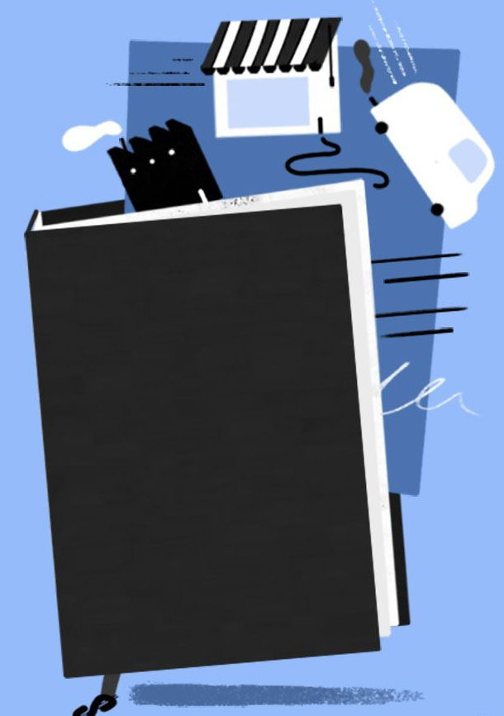
S Corporation: Negatives
Eligibility Restrictions
The IRS imposes strict requirements for S-corporation status that don't exist for partnership-taxed LLCs.
The entity can have no more than 100 shareholders, all shareholders must be U.S. citizens or resident individuals (no corporations, partnerships, or most trusts as shareholders).
There can only be one class of stock, meaning equal economic rights for all members.

Slide 64

S Corporation: Negatives
One Class of Stock Restriction.
Unlike a partnership-taxed LLC, which can use special allocations to distribute income and losses disproportionately among members, an S-corporation must allocate all income, losses, deductions, and credits strictly in proportion to ownership percentage.
This eliminates much of the economic flexibility that makes LLCs attractive for complex multi-member arrangements.
Reasonable Compensation Compliance Risk.
The IRS scrutinizes S-corporations where owner-employees take little or no salary and distribute most profits to avoid employment taxes.
Getting the "reasonable compensation" determination wrong can trigger IRS audits, back taxes, penalties, and interest.
This requires ongoing attention and documentation.

Slide 65

Increased Administrative Burden. S-corporation status requires payroll processing for owner-employees, quarterly payroll tax filings, W-2 issuance, and a corporate-level tax return (Form 1120-S) in addition to members' individual returns. This adds accounting and legal compliance costs that partnership-taxed LLCs avoid or minimize.
Fringe Benefit Limitations. Owner-employees who own more than 2% of an S-corporation are treated more like partners than employees for certain fringe benefit purposes.
This means that some benefits such as health insurance premiums, that are tax-free for C-corporation employees must be included in the owner-employee's W-2 income, though a deduction may be available at the individual level. This is a frequently overlooked disadvantage.
S Corporation: Negatives

Slide 66
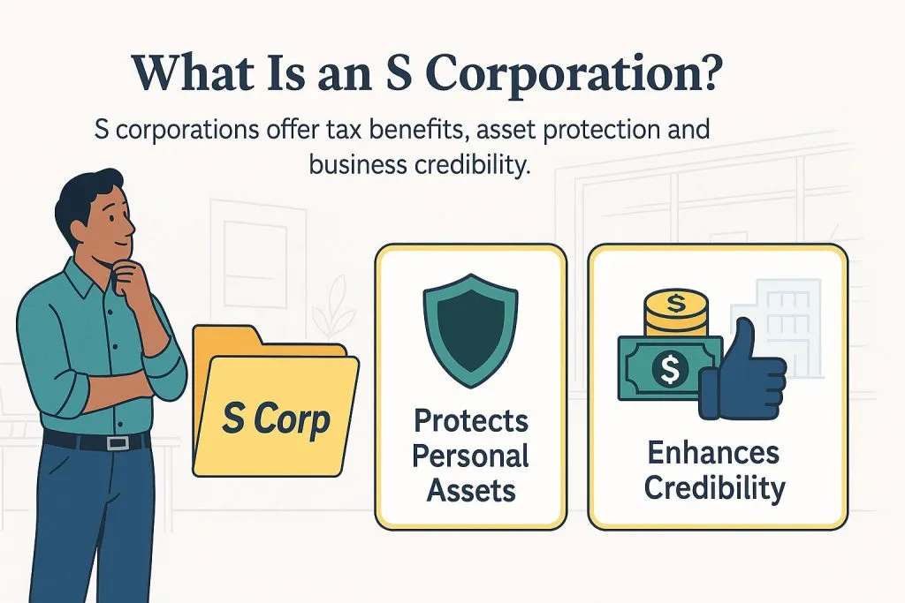
S Corporation: Negatives
Less Flexibility on Basis Rules.
S-corporation shareholders can only take basis for entity-level debt in limited circumstances, whereas partners in a partnership-taxed LLC can generally include their share of LLC debt in their basis.
Higher basis allows more loss deductions and reduces gain on disposition, so this distinction can matter significantly when the LLC carries substantial debt.
Exit and Liquidation Complexity.
Unwinding an S-corporation election or restructuring the entity can have tax consequences that are harder to manage than with a partnership-taxed LLC.
Transferring assets out of an S-corporation, for example, generally triggers gain recognition in a way that partnership distributions often do not.

Slide 67

S Corporation: Bottom Line
The S-corp election tends to make the most sense where the self-employment tax savings justify the added compliance burden.
It works less well for LLCs with passive investors, disproportionate profit-sharing arrangements, non-U.S. members, or plans to bring in institutional capital.

Slide 68
Please click “still here” when the pop-up arises.
This is an important step which verifies your attendance and assures that your credit is received.
Thank you.

Slide 69
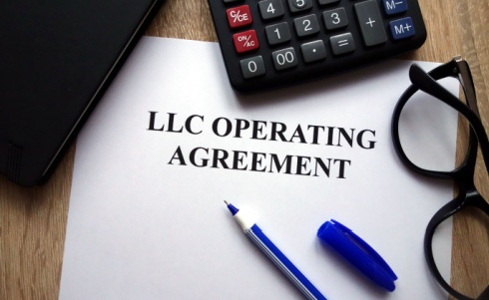
The Operating Agreement
The foundational governance document of your LLC

Slide 70
The Operating Agreement
A well-drafted LLC operating agreement is the foundational governance document of the company.
It should anticipate not just how the business will operate when things go well, but what happens when members disagree, someone wants to leave, or the business needs to wind down.
.

Slide 71
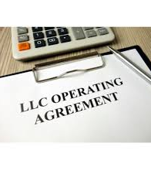
The Operating Agreement
The most commonly contested and litigated provisions — and therefore the most important to address carefully — are:
Distribution rights and tax distributions
Transfer restrictions and buyout mechanisms
Management authority and decision thresholds
Partnership representative authority
Dissolution triggers and winding up
Non-competition and confidentiality

Slide 72
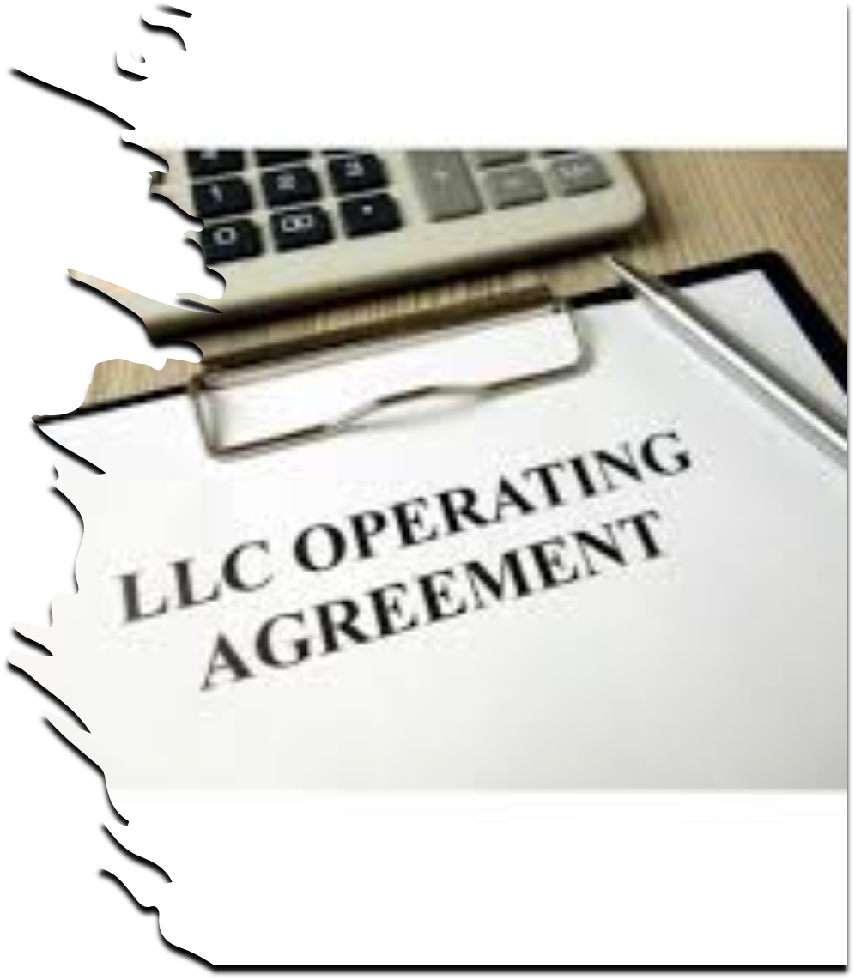
Essential Areas to Cover in an LLC Operating Agreement
A comprehensive LLC operating agreement should address the following areas.
1. Organizational Matters
2. Members and Membership Interests
3. Capital Contributions
4. Allocations of Income, Gain, Loss, and Deduction
5. Distributions
7. Member Voting and Consent Rights
8. Transfer of Membership Interests
9. Buyout and Withdrawal Provisions
10. Buy-Sell Mechanisms
11. Partnership Representative and Tax Matters
12. Books, Records, and Accounting
13. Confidentiality and Non-Competition
14. Fiduciary Duties
15. Indemnification and Liability
16. Dissolution and Winding Up
17. Dispute Resolution
18. Miscellaneous Provisions

Slide 73


Slide 74

Questions
If you have any questions
regarding this Course
Martin Pezzner
mpezzner@gibperk.com
Ted Perkins
tperkins@gibperk.com
or
(610) 565-1708 Ext. 104

Slide 75

COURSE EVALUATION
Thank you for attending our program.
You will receive an email which includes a link to the materials and the link to the Evaluations within 24 hours.
Please fill out the form, which helps us comply with the requirements of issuing CPE and CLE in various jurisdictions.

